Slide 1


Slide 2


Slide 3


Slide 4


Slide 5


Slide 6

Japan’s U.S. Investment Dynamic and JETRO’s Role
in Supporting State & Local Governments’ Efforts
to Attract Investment from Japan
Tomofumi Nishizawa
Executive Director
Japan External Trade Organization (JETRO) Chicago
4th Annual Japan - Northeast Indiana Summit
Wabash, Indiana
July 19, 2022

Slide 7




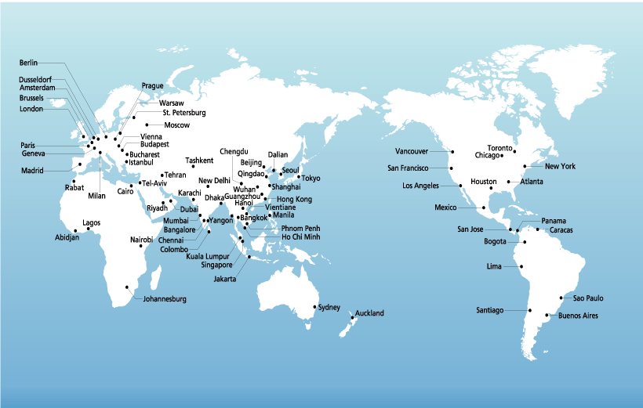
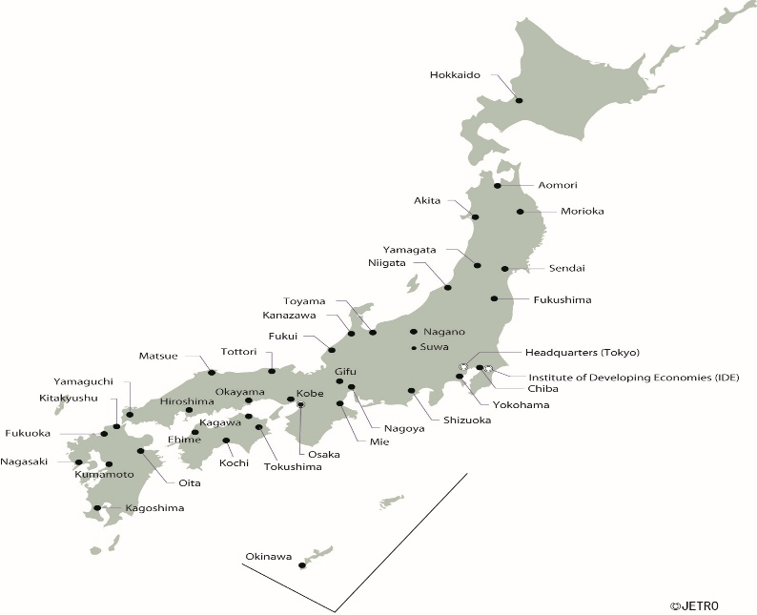
What is JETRO?
JETRO (the Japan External Trade Organization) is the official trade and
investment promotion agency of the government of Japan.
Headquartered in Tokyo with 47 offices in Japan and 74 offices in 54 countries.
6 locations in the US; New York, San Francisco, Chicago, Los Angeles, Atlanta, Houston in the U.S.
Our Missions
- Support Japanese Companies to Smoothly Enter in the U.S. Market
- Promote U.S. Direct Investment in Japan
- Promote the Export of Japan’s Agricultural and Fishery Products
- Relation Building Facilitator with Japanese companies
47 Offices in Japan
74 Offices in 54 Countries
Copyright (C) 2021 JETRO. All rights reserved.

Slide 8
Japan is #1.
The Leading Foreign Direct Investor in the United States (2020)
Since 1990, Japanese direct investment in the U.S. economy has grown steadily, total investment at the end of 2020 was $679 billion ranking first among all investor countries, ahead of Canada ($563.8 billion), Germany ($564.2 billion) and the UK ($480.8 billion).
At the end of 2020, the rate of investment increase is more than 2.8 times (182.8 %) than in 2009, the year of the U.S. financial crisis.
(B$)
$679B
$240B
2.8 times greater than in 2009
(year)
Note： Companies with 50% or more of investment from the ultimate beneficial owner (UBO).
Source： U.S. Department of Commerce
Copyright (C) 2022 JETRO. All rights reserved.
8

Slide 9
Japan is #1: Japanese Manufactures Employ 527,500 Americans, the Highest Among All Investor Countries (2019)
The total number of Americans employed by Japanese-owned manufacturing companies in the U.S. reached a record level, 527,500 in 2019 – the largest increase during that period among investor countries. It has increased by 238,100 (82.3%) since 2010.
In contrast, the total number of employees in the overall U.S. manufacturing sector only showed an increase of 129,000 (11.2%) during the same period. Japan’s employment growth was the largest among major investor countries, far ahead of the second largest investor: China (65,200).
Up 82.3% since 2010
Employee（in 1,000s）
Employee（in 1,000s）
(year)
Note: Companies with 50% or more of investment from the ultimate beneficial owner (UBO).
Source: U.S. Department of Commerce “Activities of U.S. Affiliates of Foreign Multinational Enterprises”
Copyright (C) 2022 JETRO. All rights reserved.
9

Slide 10
Japan is #1. Exports by Japanese-Owned Companies in the U.S.: $82.3 billion, a Record Level of Growth (2019)
Total exports by Japanese companies in the U.S. reached a record level of growth of $82.3 billion (2019), the largest among investor countries. This amount accounts for 20.7% of all foreign company exports and 5.0% of total U.S. exports.
Foreign Owned
Company Exports ($B)
Japan
United Kingdom
Germany
France
Canada
Note: Companies with 50% or more of investment from the ultimate beneficial owner (UBO).
Source: U.S. Department of Commerce, "Activities of U.S. Affiliates of Foreign Multinational Enterprises“
(year)
Copyright (C) 2022 JETRO. All rights reserved.
Notes:
【参照Excelシート】スライド標題No.17 在米日系企業による輸出、 No.17 在米日系企業による輸出（元データ2019）
【参照箇所】 No.17 在米日系企業による輸出 おもにＸ～ＡＡ列
●GDP比は以下のように計算しました。
2019年名目GDP 21372.6【10億ドル】 (「JETRO 国・地域別情報 基礎的経済指標」より取得）
82.3÷21372.6=0.0038507… ⇒約0.4%(←丸めた数字としては昨年版の記載と変わりなし）
（別途、BEA(http://www.bea.gov/national/)から取得したデータとも一致→シート「米国GDP」(エクセルの左から2シート目）参照 セル2019）

Slide 11

FY2021 JETRO Survey on Business Conditions for Japanese Companies Operating Overseas
- This is the 40th annual survey, conducted since 1981
- 851 companies responded including 242 Midwest companies.
https://www.jetro.go.jp/en/news/releases/2022/498ee8912a97a65e.html
March 25, 2022
Japan External Trade Organization (JETRO)

Slide 12
Future Business Direction:
Close to 50% Plan to Expand (Recovery)
2. Future Business Direction
2-1
In the last survey, a little less than 40% (39.1) of respondents said they had their sights on business expansion in the next one to two years, but in this survey, such respondents increased close to 50% (48.1%). Industries that showed a high “expansion” percentage were food (74.2%) and precision machines/medical equipment (70.0%) among manufacturers, and finance/insurance (64.3%) among non-manufacturers.
When asked about the main reason for business expansion in the next one to two years, a little less than 90% (89.6%) chose “sales increase in local markets,” followed by “high growth/potential” (39.2%) and “high receptivity for high-value added products/services” (27.3%).
When asked about functions that will be expanded, 65.4% chose “sales function,” followed by production (high-value added products, 35.1%) and production (general-purpose products, 20.1%).
Trends in Business Expansion for Next 1-2 Years
（％）
（Year）
(Note) This charts lists only the industry types for which valid responses were received from at least 10 companies.

Slide 13
Management Challenges: “Slow Development of New Customers” and “Increase in Wages of Employees” Are Top Answers
8. Management Challenges
and Responses
8-1
With respect to management challenges, “slow development of new customers” was the most common answer (62.0%), while “increase in wages of employees” (57.9%) and “rising logistics costs” (53.3%), “rising procurement costs” (52.2%) were cited by over 50% of the respondents. By industry, “slow development of new customers” was a widely shared challenge among retail trade (90.9%) and trading/wholesale (86.7%), while “increase in wages of employees” was cited by more than 80% of the respondents in textiles/textile apparel (85.7%), automotive etc. parts (84.4%) and automobiles etc. (81.8%).
Management Challenges (Multiple Answers, TOP10)
(%)
# of respondents:831
(Note) Only the top response items are listed in this chart.

Slide 14
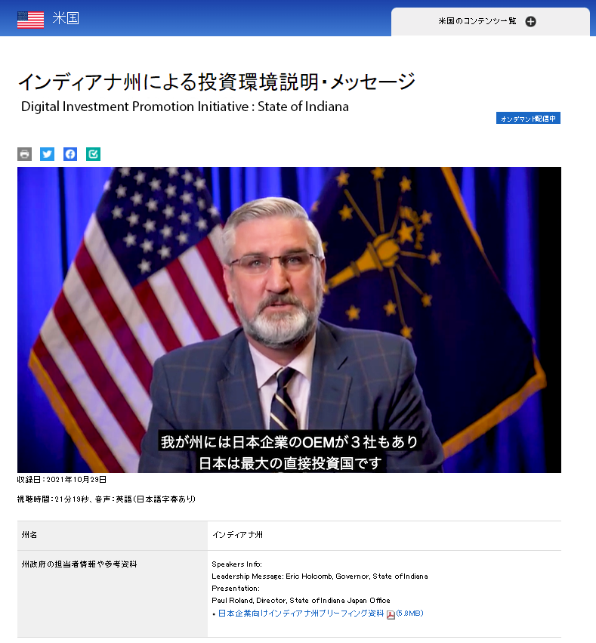
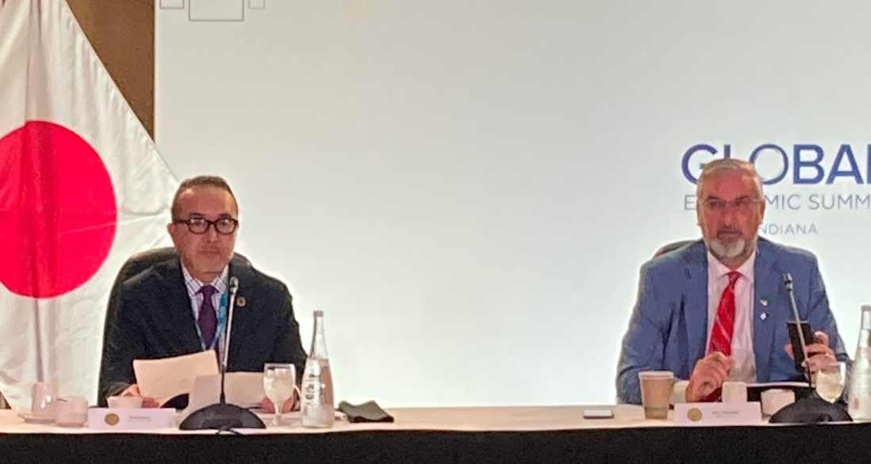
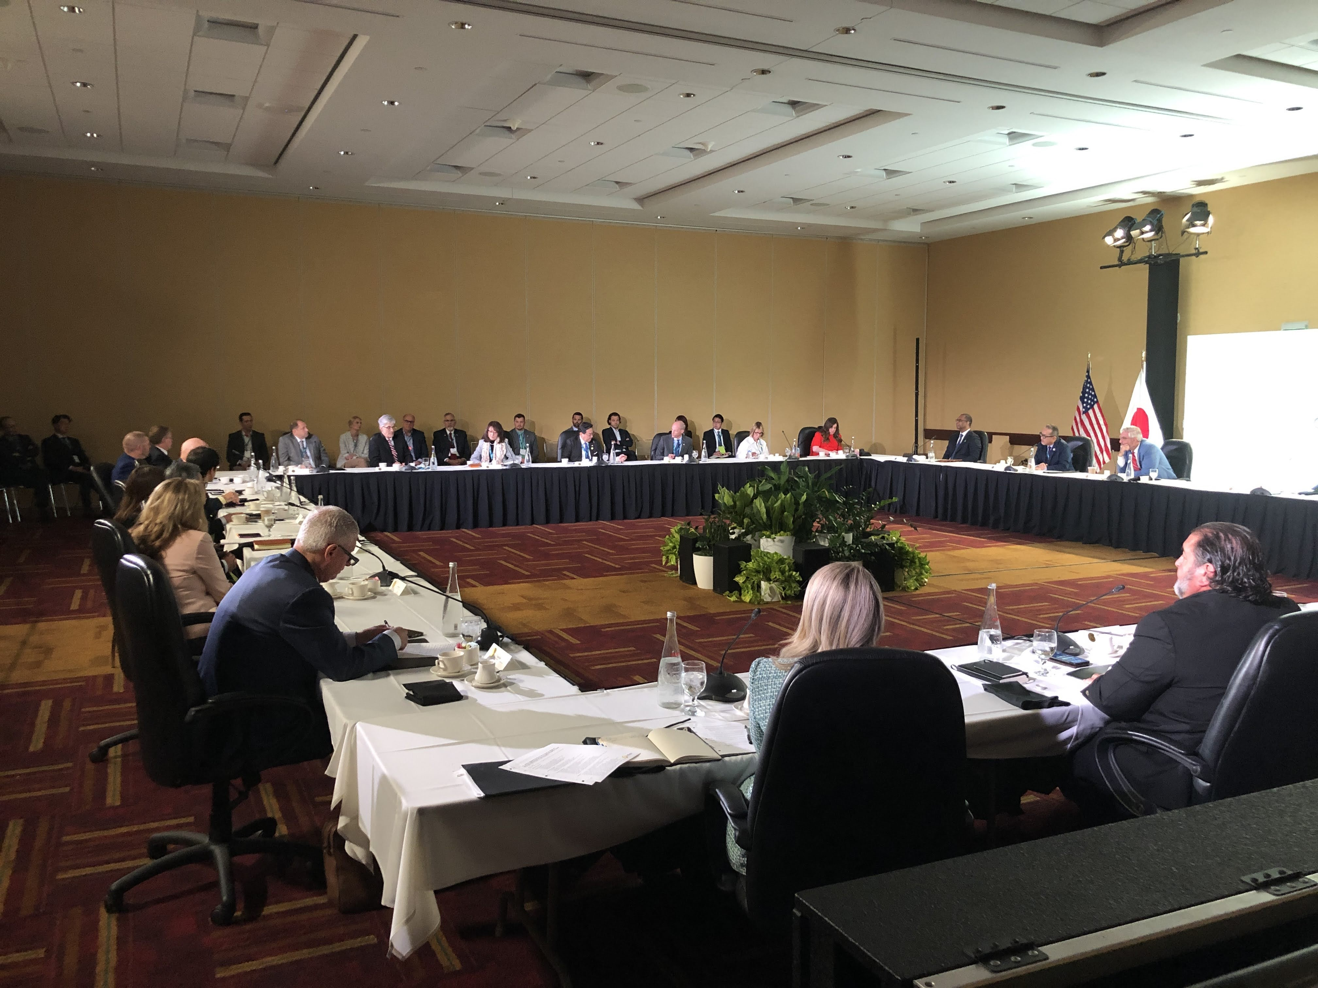
JETRO Initiatives
Messages from U.S. Governors and State Economic Development Leaders to Japan’s Business Community
JETRO Digital Investment Promotion Initiative
Indiana Global Economic Summit
Indiana Governor, Eric Holcomb
Indiana Governor, Eric Holcomb
May 26, 2022 Japan Roundtable
U.S. and Japan: Perspectives of the Electrification of the Automotive Supply Chain - Opportunities in Transition
34 of 50 States Participated
Messages from 24 Governors

Slide 15
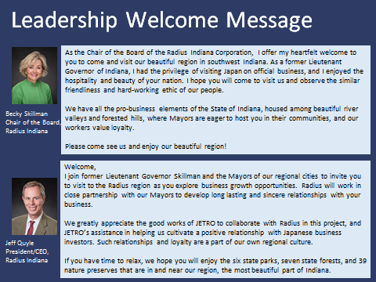
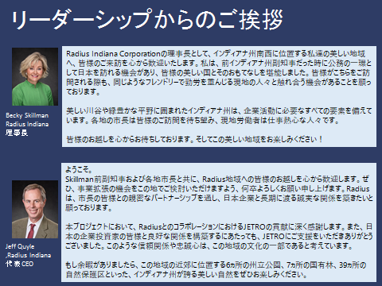
RADIUS INDIANA – Mayors Messages
English version
Japanese version

Slide 16

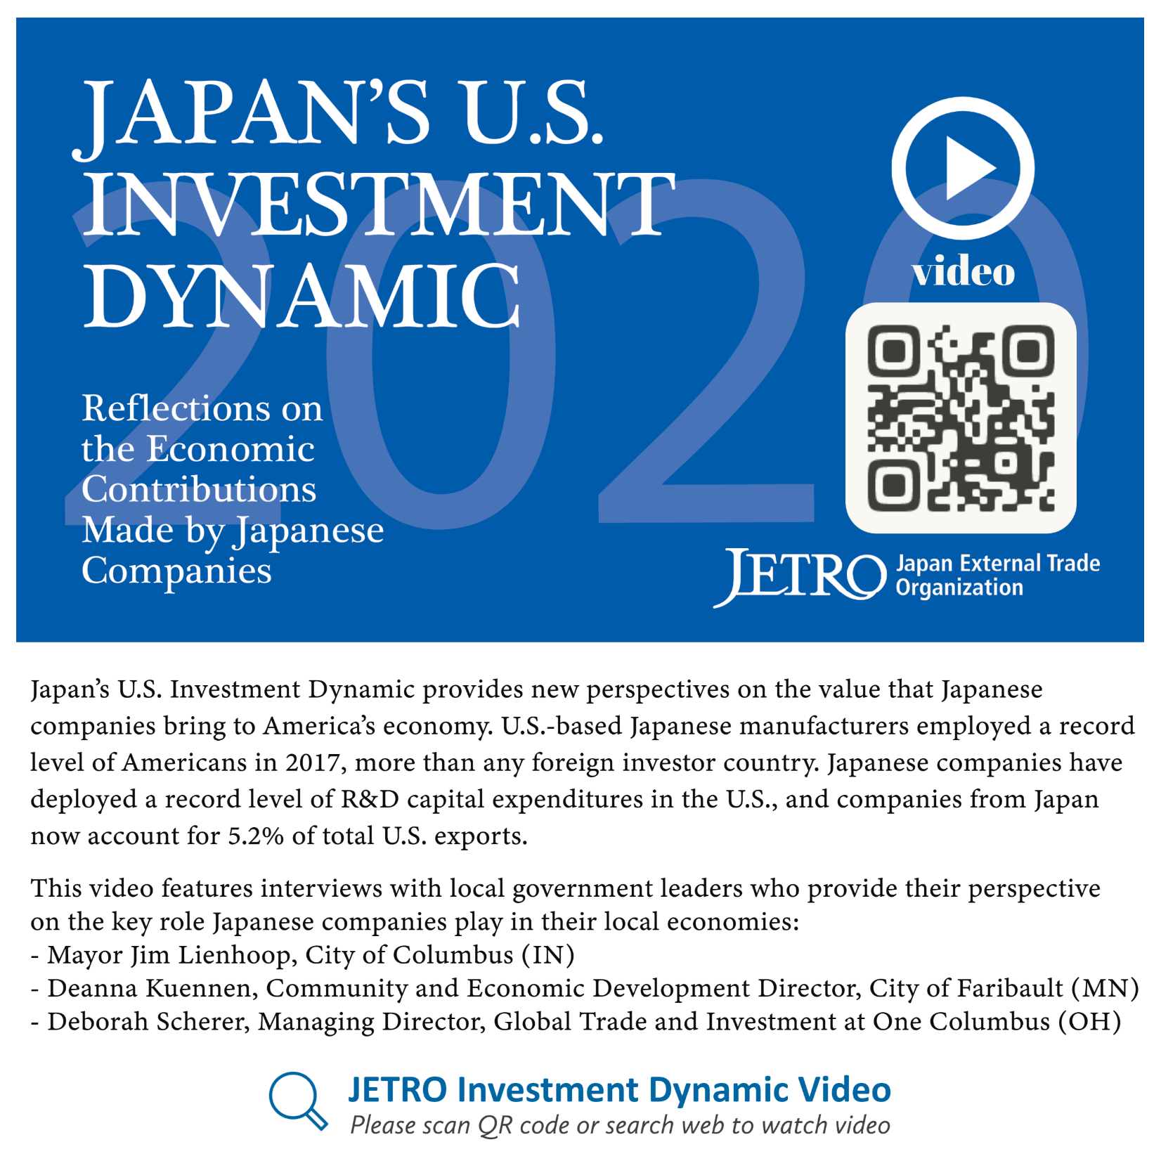
JETRO Publications: Japan’s U.S. Investment Dynamic
Booklet
Video
Mayor Jim Lienhoop
City of Columbus, Indiana
Deanna Kuennen
Community and Economic Development Director
City of Faribault, Minnesota
Deborah Scherer
Managing Director, Global Trade and Investment
One Columbus​​​, Ohio
Copyright (C) 2022 JETRO. All rights reserved.
16

Slide 17

Atlanta
Chicago
Houston
Los Angeles
New York
San Francisco
Thank you for your attention.
For more details, please contact JETRO Chicago:
Tomofumi Nishizawa
Executive Director
Tomofumi_Nishizawa@jetro.go.jp​
JETRO USA: https://www.jetro.go.jp/usa/contact-us.html
Copyright (C) 2022 JETRO. All rights reserved.

Slide 18


Slide 19
The Future is Electrifying
-Automotive Industry Update and Forecasts
Japan-Northeast Indiana Summit
Bernard Swiecki – Director, Research
July 19, 2022

Slide 20
MISSION: to produce independent research, convene stakeholders, and analyze critical issues facing the mobility industry and its impact on the economy and society.

Slide 21
THE CENTER FOR AUTOMOTIVE RESEARCH (CAR)
Automotive industry contract research and service organization (non-profit ) with more than 30 years experience forecasting industry trends, advising on public policy, and sponsoring multi-stakeholder communication forums.
RESEARCH
EVENTS
CONNECT
Independent research and analysis on critical issues facing the industry.
Industry-driven events and conferences that deliver content, context, and connections.
Consortia that bring together industry stakeholders to participate in working groups, networking opportunities, and access to CAR staff.

Slide 22

About the Automotive Communities Partnership (ACP)
Helps communities adapt and position themselves for new automotive products, technologies, and investments
Member-based, non-profit, community-industry partnership
Links major automotive activity centers to each other and to companies
Goal: Increase regional automotive growth

Slide 23
Leverage your Engagement with ACP …
Ask Us!
Research & Content
Insights
Speaking Engagements
Collaborations
Leverage CAR staff as your resource for information, insights, content, context and more… Just Ask
CAR economic forecasts, data and presentation support, private access to exclusive content for planning and analysis
Direct access to CAR staff and subject matter experts for strategic planning, data and insights
Public & Private speaking engagements, strategic planning sessions, board or finance meetings
Engage with CAR and network with industry stakeholders through collaborative working groups & events

Slide 24
ACP Program Benefits
On a regular basis, ACP provides
  A webinar featuring
    Automotive sales and production update
    North American automotive investment update
    Featured speaker deep dive on key automotive topic
  A newsletter featuring
    Summary and link to latest edition of Book of Deals automotive investment update
    Summary and link to the latest ACP webinar recording and presentation
    Details on next month’s ACP webinar
    Links to CAR research and webinars relevant to automotive economic development

Slide 25
ACP Program Benefits
ACP provides on-demand access and information, including
  Forecasts of vehicle production for the automotive plants on which your community’s suppliers rely
    Forecasts are available at the model and plant levels
    Engine and transmission plant sourcing can be tied to vehicle production forecasts, identifying which plants rely on each other the most – and how that will change in the future
    Investment trend analysis for a specific plant, county, or state, including known incentive data
    Information on automotive suppliers who may be considering investing in your community
      Financial state
      Prior investments in North America, including incentives received
      Review of product portfolio for suitability for Just In Time shipping to plants in your community
  Presentations at your community’s events
  Experts with whom you can consult on any automotive subject
  Assistance in running automotive taskforces

Slide 26
Additional ACP Program Benefits
Quarterly Automotive Dashboard
Significant discounts on CAR automotive conferences and webinars
Invitations to attend regional ACP meetings held throughout the region
Networking opportunities

Slide 27
Industry Update

Slide 28
Year-to-date sales are down compared to 2021
Source: Wards Auto; CAR Research
Notes:
Updated: 7/5/2022 By: Tina
Boxes: YTD Sales Volume / Change in YTD Sales from previous period/ YTD Market Share

Slide 29
U.S. light vehicle SAAR increased in June
Source: Wards Auto; CAR Research
Notes:
Updated: 7/5/2022 By: Tina

Slide 30
Monthly sales trend below last year’s level
Source: Wards Auto; CAR Research
Notes:
Updated: 7/5/2022 By: Tina

Slide 31
Middle CUVs are the top segment in the market
Source: Wards Automotive Reports
Notes:
Updated: 7/5/2022 By: Tina
Note: luxury CUVs are separated from regular CUVs

Slide 32
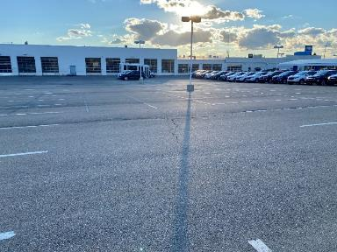
New vehicle inventories are at their lowest levels since October 2009.
Source: Wards Auto; Cox Automotive; author’s photograph

Slide 33
Vehicle Electrification

Slide 34

EVs are having a moment
REGULATORY
TECHNOLOGY
PRODUCT
FINANCE
MARKET
Global regulations are quickly moving to lower-carbon transportation
Technology is more capable with longer range & lower costs
EVs will soon be available in every segment—from compacts to pickups
Investors are rewarding market disruptors & sustainable companies
EV market share is increasing—unrelated to real gas prices

Slide 35
Electrified vehicles take up 12.2% of the LV market
Note: Electrified Segment consists of BEVs, HEVs and PHEVs; all other segments are sales exclusive of Hybrid models
Source: Wards Automotive Reports and CAR Research
Notes:
Updated: 7/5/2022 By: Tina

Slide 36
Electrified vehicles see a massive increase in year-to-date sales since last year
Note: All other segments are sales exclusive of Hybrid models
Source: Wards Automotive Reports and CAR Research
Notes:
Updated: 7/5/2022 By: Tina

Slide 37
Hybrid, Plug-In Hybrid, and BEVs are all at historically high market shares in the new year
Note: Electrified vehicles consist of BEV, HEV and PHEV
Source: Ward’s Automotive Reports (from 2010 and on), HybridCars.com and CAR Research
Notes:
Updated: 7/5/2022 By: Tina
Note: Tesla sales are estimated.

Slide 38
EV Releases, Sales, and Production Projections
Ford
40%-50% of global vehicle volume to be electric
Subaru
40% of global sales will be EVs or HEVs
GM
50% of NA assembly capacity will be converted to EV production
GM
70% of Euro sales will be EVs
Hyundai
Sell 1.87M EV/year
11 New models
Kia
Sell 1.2M EV/year
Volvo
Fully Electric
Toyota
Sell 3.5M EVs/year
Stellantis
50% of US sales BEV
100 % of Euro sales BEV
25 models by this time
Nissan
40% of sales to be EVs
Genesis
Internal combustion vehicles phased out
Genesis
EVs will be the only new models
Ford
Have sold a total of 1M EVs
Begins battery production in Kentucky plant
GM
30 models by this time
Kia
20% of sales in Euro, NA, and Korea will be EVs
Audi
20 models by this time
VW
ID.2 production will begin
Ram
Ram 1500 EV released
Mercedes
50% of sales to be EVs
Nissan
EV plant will begin assembly in Mississippi
Tesla
936k EVs delivered
Ford
Mache E sells over 27,000
Audi
80,000 EV sold
GM
Chevy sold over 20,000 EVs
Mercedes
99,000 EVs sold
Jaguar
i-Pace sold 9,970
Rivian
Delivered and sold around 1,000 EVs
Kia
Over 8,000 EVs sold
VW
263K BEVs delivered
Volvo
25K BEVs sold
GM
400,000 EVs delivered
Ford
600,000 EVs produced
Kia
Two EV models will be released
VW
Ability to produce 1M EVs/year in China
Stellantis
First Jeep EV released
GM
Six-fold increase in EV truck and SUV production
Ford
Projecting at least a 25% growth in EV revenue and several new models
Tesla
Projecting over 1.4M EVs delivered
Rivian
Production begins in their Georgia plant
Audi
Starts production in Chinese that aims to produce 150,000 EVs/year
Kia
14 EV models by this time
2023
2025
2027
2030
2024
2022
2021
Source:
Naseeb Souweidane research database
Notes:
Methodology and sources:
Only represented if the following conditions apply:
Official company announcement or statement by corporate officer
Reference to specific year, if not more specific
Specified SAE J3016 level 3+ or provides enough detail to be confidently inferred
Mixed vehicle traffic (does not include protected guideways or pedestrian-only zones)
If level 4/5, no human operator (really)
Motional:
https://motional.com/news/introducing-motionals-next-generation-robotaxi-the-hyundai-ioniq-5
Udelve (Intel-Mobileye ADS):
https://www.intel.com/content/www/us/en/newsroom/news/mobileye-udelv-deal-autonomous-delivery.html
TransDev (Mobileye ADS):
https://www.intel.com/content/www/us/en/newsroom/news/mobileye-transdev-ats-lohr-group-av-shuttles.html
Waymo:
https://www.theverge.com/2017/11/7/16615290/waymo-self-driving-safety-driver-chandler-autonomous -
https://finance.yahoo.com/news/waymo-tests-rider-only-looks-170335188.html
https://twitter.com/EricPaulDennis/status/1227618453743374338?s=20
Audi:
https://www.audiusa.com/newsroom/topics/2016/audi-piloted-driving -
http://spectrum.ieee.org/cars-that-think/transportation/self-driving/nvidia-ceo-announces
http://audimagazine.com.au/post/audi-ai-traffic-jam-pilot
https://blog.caranddriver.com/traffic-jamming-in-the-2019-audi-a8-we-let-automated-driving-tech-take-the-wheel/
Also, that guy Stadler said level 5 by 2025-2030 but he was later arrested and fired.
Program cancelled: https://europe.autonews.com/automakers/audi-quits-bid-give-a8-level-3-autonomy
Level 4: https://spectrum.ieee.org/cars-that-think/transportation/self-driving/nvidia-ceo-announces
Lyft (GM ADS):
https://medium.com/@johnzimmer/the-third-transportation-revolution-27860f05fa91#.w4y2aw3ug
Ford-Argo:
https://media.ford.com/content/fordmedia/fna/us/en/news/2016/08/16/ford-targets-fully-autonomous-vehicle-for-ride-sharing-in-2021.html
https://fordauthority.com/2020/04/ford-autonomous-vehicle-services-postponed-until-2022-because-of-covid-19/
Argo-Lyft tie-up stated YES safety drivers : https://media.ford.com/content/fordmedia/fna/us/en/news/2021/07/21/argo-ai-ford-lyft-network.html
BMW:
https://www.press.bmwgroup.com/global/article/detail/T0261586EN/bmw-group-intel-and-mobileye-team-up-to-bring-fully-autonomous-driving-to-streets-by-2021?language=en
https://www.bmwblog.com/2017/10/29/bmw-shares-us-autonomous-technology-roadmap/
https://www.bmwblog.com/2018/09/24/klaus-frohlich-to-talks-about-bmw-inext/
https://bmwmovement.org/bmw-releases-safety-assessment-report-of-autonomous-vehicle-testing/
Mercedes:
https://europe.autonews.com/article/20170310/ANE/170309921/daimler-r-d-boss-outlines-mercedes-self-driving-ev-connectivity-plans
http://www.forbes.com/sites/matthewdepaula/2013/09/30/autonomous-driving-will-become-an-option-on-regular-mercedes-models-by-2020/#594c825d275c
https://www.autocar.co.uk/car-news/motor-shows-shanghai-auto-show/mercedes-owners-drive-hands-free-autonomous-tech-2020 - https://www.futurecar.com/2728/Mercedes-to-Offer-Level-3-Autonomous-Driving-on-the-Next-S-Class
https://www.daimler.com/innovation/case/autonomous/legal-framework.html
Volvo:
http://www.businessinsider.com/volvos-first-self-driving-car-is-coming-in-2020-2016-5
http://www.nydailynews.com/autos/news/volvo-self-driving-car-technology-pilot-program-gothenburg-article-1.3442614 http://www.autonews.com/article/20171212/COPY01/312129966/volvos-drive-me-takes-detour-on-road-to-full-autonomy
https://www.thecarconnection.com/news/1117336_self-driving-volvo-xc90-crossover-suv-planned-for-2021
VW (Mobileye ADS)
https://newsroom.intel.com/news-releases/volkswagen-mobileye-champion-motors-invest-israel-deploy-first-autonomous-ev-ride-hailing-service/#gs.3eiy82
https://www.calcalistech.com/ctech/articles/0,7340,L-3754013,00.html
VW (Argo ADS)
https://media.vw.com/en-us/releases/1481
VW-Audi (2021)
This was previously in their “Strategy 2025 Plan.” It no longer is and I lost a good link. Here’s a Wayback link:
https://web.archive.org/web/20170808175159/http://www.volkswagenag.com/presence/konzern/pdf/Group_Initiatives_Strategy_2025.pdf
https://web.archive.org/web/20170831092154/http://together.volkswagenag.com:80/en/
Moar VW: Vague plans for 2030: https://techcrunch.com/2021/07/13/volkswagens-new-business-strategy-puts-software-and-autonomous-driving-front-and-center/
https://www.volkswagenag.com/en/group/strategy.html
“The aim of the fifth initiative is to bring highly automated driving functions to market as a core competency from 2021. This involves private vehicles, shared mobility systems and commercial mobility providers.”
Comma.AI:
https://youtu.be/aqdYbwY9vPU?t=1185 “It’s going to be at least another 3 years before we solve the problem.”
https://twitter.com/comma_ai/status/939221105272692736
2getthere:
https://www.maakindustrie.nl/nieuws/autonome-parkshuttle-gaat-openbare-weg-rijden (confirmed via Twitter) , later said, “late 2020, early 2021” https://twitter.com/2getthereZF/status/1176899924463456256?s=20
old promise: https://www.2getthere.eu/1st-autonomous-vehicle-public-road/
Cruise:
Dan Ammann, November 30 2017, investor conference. Repeated several times since even by Barra and Vought
https://www.reuters.com/article/us-gm-autonomous/gm-plans-large-scale-launch-of-self-driving-cars-in-u-s-cities-in-2019-idUSKBN1DU2H0
And kaput. https://medium.com/cruise/the-next-steps-to-scale-start-in-san-francisco-713315f3a142
Dubai: https://www.mediaoffice.ae/en/news/2021/April/12-04/Hamdan-bin-Mohammed-attends-signing-of-agreement-between-RTA-and-Cruise-to-operate-self#.YHheusjViRo.twitter
Tesla:
https://www.reuters.com/article/us-tesla-selfdriving-idUSBRE98H01720130918
http://fortune.com/2015/12/21/elon-musk-interview/
https://electrek.co/2017/12/08/elon-musk-tesla-self-driving-timeline/
https://seekingalpha.com/article/4298445-tesla-inc-tsla-ceo-elon-musk-q3-2019-results-earnings-call-transcript?part=single
https://www.cnet.com/roadshow/news/elon-musk-full-self-driving-tesla-earnings-call/#:~:text=According%20to%20Musk%2C%20the%20FSD,%2C%22%20according%20to%20the%20CEO.
Honda:
https://www.marketwatch.com/story/honda-still-on-track-for-at-least-some-kind-of-self-driving-car-in-2020-2019-12-09?mod=mw_share_twitter
https://www.theverge.com/2017/6/8/15761272/honda-self-driving-cars-autonomous-level-4-date
https://hondanews.com/en-US/releases/release-e86048ba0d6e80b260e72d443f0e4d47-honda-launches-next-generation-honda-sensing-elite-safety-system-with-level-3-automated-driving-features-in-japan <- Have not confirmed these have actually been leased to peoples.
Transdev (Mobileye ADS):
https://www.intel.com/content/www/us/en/newsroom/news/mobileye-transdev-ats-lohr-group-av-shuttles.html
Nissan:
https://newsroom.nissan-europe.com/uk/en-gb/media/videos/108589/nissan-announces-autonomous-drive-plan-by-2020
Andy Palmer “True independence and mobility for all.” TBF, said this WAY back in 2013.
Later said 2022. Revision? Something else?
https://www.nissanusa.com/blog/autonomous-drive-car
https://www.bloomberg.com/news/articles/2017-12-06/nissan-plans-to-introduce-fully-autonomous-driving-cars-in-2022
Nuro:
https://medium.com/nuro/az-pilot-launch-33cceb55c871
Mobileye with SIXT – Doesn’t actually pledge to remove driver in 2022.
https://www.intel.com/content/www/us/en/newsroom/news/mobileye-sixt-plan-new-robotaxi-service.html
May Mobility:
https://medium.com/mobility-entrepreneurship/interview-with-alisyn-malek-co-founder-and-coo-of-may-mobility-bbdd48dfe5c
Drive.AI
https://www.theverge.com/2018/7/30/17622540/drive-ai-self-driving-car-ride-share-texas “Goal is to pull driver out of vehicle by end of year.”
Rivian:
https://www.rivian.com/technology
Plan 2020 debut of electric pickup. Website claims level 3 automation will be standard.
Baidu:
http://apollo.auto/
Project Apollo timeline: 2019 “Production-level Geo-fenced city roads autonomous driving”
TuSimple:
Chief Product officer pegs late 2020 to 2021 for “commercial driverless operation.” https://moneymaven.io/mishtalk/economics/self-driving-truck-startup-tusimple-confident-of-commercial-driverless-by-2021--FY5ce4I4UCGUPXRgzavRQ/
VP of Product actually claimed technology will be ready by late 2020 (but I don’;t have room in that year) https://www.ttnews.com/articles/tusimple-proceeds-plans-build-worlds-largest-self-driving-truck-fleet
Success:
https://electrek.co/2021/12/29/tusimple-successfully-operates-80-mile-autonomous-semi-truck-ride-on-public-roads-without-a-human-present/
Renault:
https://group.renault.com/en/news/blog-renault/renault-presents-eyes-offhands-off-technology-for-the-autonomous-vehicle-of-the-future/
Yandex:
https://www.youtube.com/watch?v=nhqyrze30bk
PSA Groupe:
https://www.groupe-psa.com/en/story/en-route-vers-la-voiture-autonome/ (2024)
I had them down for 2023 level 3, but I didn’t document and can’t find the press release as everything was deleted with Stellantis.
Making this grey as Stellantis probably shouldn’t be associated with earlier pledges.
Hyundai (w Aurora):
https://www.hyundai.news/eu/articles/press-releases/hyundai-motor-and-aurora-partner-to-develop-level-4-autonomous-vehicles-by-2021.html
Aurora:
https://drive.google.com/file/d/1zr0J6h6islsJoHSVKIHwkh1k2RaCCjwb/view
p. 46: “Aurora anticipates beginning to generate revenue from trucks without drivers in 2023.” Ridehailing in 2024.
Plus.AI. https://plus.ai/investors.html?gclid=CjwKCAjwjJmIBhA4EiwAQdCbxmWmN8oB8EJIJvnP2JSC2jQFcNHHLkypiO8p85QETKD-OCGLdCY2WBoCHcoQAvD_BwE
--------------------------------------------------
March 2019 revision
Removing suppliers since they aren’t really pledging deployment, but a “platform.”
Conti with Nvidia pledged L2-5 platform by 2021: https://nvidianews.nvidia.com/news/continental-and-nvidia-partner-to-enable-worldwide-production-of-ai-self-driving-cars
Aptive/Mobileye level 4/5 “turnkey solution” by 2019. (relates to VW 2019 Israel promise): http://www.aptiv.com/media/article/2017/11/26/mobileye-and-delphi-to-establish-partnership-for-sae-level-4-5-automated-driving-solution-for-2019
Bosch L3 platform in 2020: https://drive.google.com/file/d/0B7uiYk-iv-WNZXItSFpQaWpsWGs/view?usp=sharing
Aptive/Mobileye: http://www.aptiv.com/media/article/2017/11/26/mobileye-and-delphi-to-establish-partnership-for-sae-level-4-5-automated-driving-solution-for-2019
NVIDIA: Will have chip in 2019, but hasn’t really promised capability.
https://blogs.nvidia.com/blog/2017/10/10/gtc-europe-holodeck-drive-px/
Rando:
Toyota:
Not specific enough to hold them to a promise.
“The first milestone comes in 2020, when Toyota plans to introduce vehicles capable of driving themselves on highways.”
https://www.autonews.com/mobility-report/toyotas-moonshot-self-driving-car-sale-year
Yandex:
https://www.autonews.com/mobility-report/russias-yandex-plans-bold-step-self-driving-cars (might actually be planning dedicated tele-operator)
Had this as a promise, but removed it when Yandex demoed crewless operation in Ann Arbor. It’s not the same but it’s too confusing to have both.

Slide 39
Announced Automaker AV/EV-Related Investments by Country
2015 to June 2022
The automotive industry has invested heavily in Electrified Vehicle (EV) and Automated Vehicle (AV) technology and capacity since 2017. In 2021 and the first half of 2022, some of the largest investments in the U.S. automotive industry history were announced. These investments over this 18-month span will contribute more than USD 70.0 billion to AV and EV technologies.
1) Ford: Blue Oval City and Blue Oval SK, USD 11.4 billion total
2) Hyundai-Kia: Plants in Georgia and Alabama for EVs and hydrogen fueling infrastructure, USD 12.9 billion total
3) Rivian: Georgia assembly plant, USD 5 billion total
4) Stellantis and LG Energy joint venture battery manufacturing facility in Windsor, Canada, CAD 5.0 billion (USD 4.1 billion)
Source: CAR Book of Deals Database

Slide 40
Biden Administration Executive Order
The path to 50%
Announced 5 August 2021 at White House ceremony attended by representatives from General Motors, Ford, Stellantis, and UAW
Goal of 50% sales of emissions-free vehicles by 2030
Emissions-free vehicles defined as
  Battery Electric Vehicles (BEV)
  Plug-In Hybrid Electric Vehicles (PHEV)
  Fuel Cell Electric Vehicles (FCEV)
Automakers’ pledges to meet the targets are voluntary
  Critics point out they will not be held to the commitments
  But prior company announcements and industry forecasts show the automakers already on a likely path to achieve compliance by 2030

Slide 41
A long way to go to get to net zero by 2050
2010-2021 YTD actual; 2021-2030 projected
50%
20%
Source: Ward’s Automotive Reports (from 2010 & on), HybridCars.com & CAR Research

Slide 42
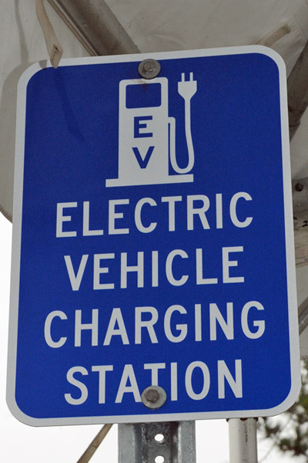
Funding to help reach the 50% target
Infrastructure Investment & Jobs Act
USD 1.2T bipartisan spending bill
Passed Senate 10 August 2021 (69-30) & House 5 November 2021 (228-206 including 13 Rs)
Contains USD 550 billion in new spending for traditional infrastructure (highways, bridges, waterways, transit, electrical grid, and broadband)
Of that new spending, USD 7.5 billion for electric vehicle charging
(goal of 500K chargers)
The funding for public chargers states they must be non-proprietary, meet applicable safety standards, open access, and, use publicly available payment methods
Also includes funding for vehicle safety & updating the electric grid
Source: Wikimedia Commons

Slide 43

Maybe more funding to help reach the 50% target? Consumer EV incentives
Build Back Better – Dead in current name and form (but portions are likely to be resurrected in future legislation).
What is likely in future legislation?
  Potentially separate bills to fund a wide array of social, economic programs, & environmental programs
  Replacement of existing EV consumer tax credit with an uncapped program
  Incentives for used EV purchases
  Inclusion of greater array of EVs

Slide 44
Forecasts

Slide 45
U.S. Light Vehicle Sales Forecast
2022-2030
U.S. Light Vehicle sales in Q2 2022 were sluggish at 13.4 million SAAR, lower than Q1 sales of 14.2 million SAAR. Inflation, gasoline prices, vehicle prices, and interest rates negatively affect the U.S. motor vehicle market. The war in Ukraine continues into its fifth month and is the largest risk to the global economic situation. CAR's sales forecast calls for a sales decline to 14.4 million in 2022, followed by a strong rebound to 16.3 million in 2023. By 2025, the U.S. market is expected to reach 17.3 million units.
Source: CAR Research, June 2022

Slide 46
U.S. Motor Vehicle Production Forecast
2022-2030
Supply chain disruptions and parts shortages remain challenges in Q2, but the worst situation might have passed. U.S. motor vehicle production in Q2 was the strongest in more than a year. CAR's forecast anticipates that supply chain issues will gradually improve and be largely resolved by the third quarter. Because of the delayed recovery, CAR expects U.S. production will decline slightly to 9.0 million by year-end, followed by a recovery of 10.4 million units in 2023. U.S. motor vehicle production will return to 11.8 million units by 2025.
*Includes medium and heavy-duty trucks
Source: CAR Research, June 2022

Slide 47
Legacy Automakers’ EV Production Will Surpass Disruptors By 2023
2022–2029 forecast
*Electric Vehicle (EV) includes: BEV, PHEV, and FCEV
Source: LMC Automotive, Q1 2022

Slide 48
Electric/Electrified Models Will Proliferate
2022–2029 forecast
*Electric Vehicle (EV) includes: BEV, PHEV, and FCEV
Source: LMC Automotive, Q1 2022

Slide 49
Concluding Thoughts
The automotive industry is reeling from a series of disruptions
  Pandemic
  Semiconductor shortage
  Shortages of other materials
  Global inflation escalation
Each of these disruptions has furthered already-unfolding trends
  Vehicle segmentation
  Pricing
  Content
This industry is transforming to electrification while simultaneously dealing with these disruptions
Electrification, plus many of the changes above, will further accelerate the industry’s need for semiconductors and other scarce resources

Slide 50
Thank You
bswiecki@cargroup.org

Slide 51


Slide 52

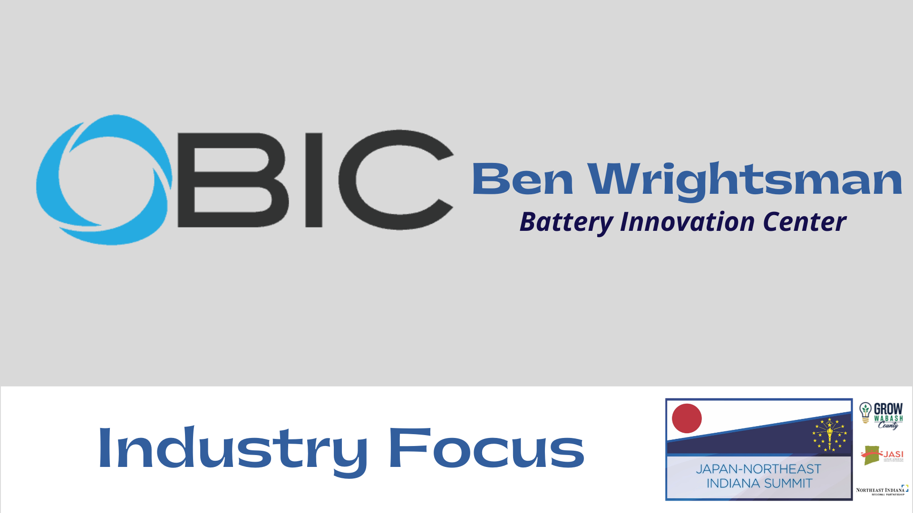

Slide 53
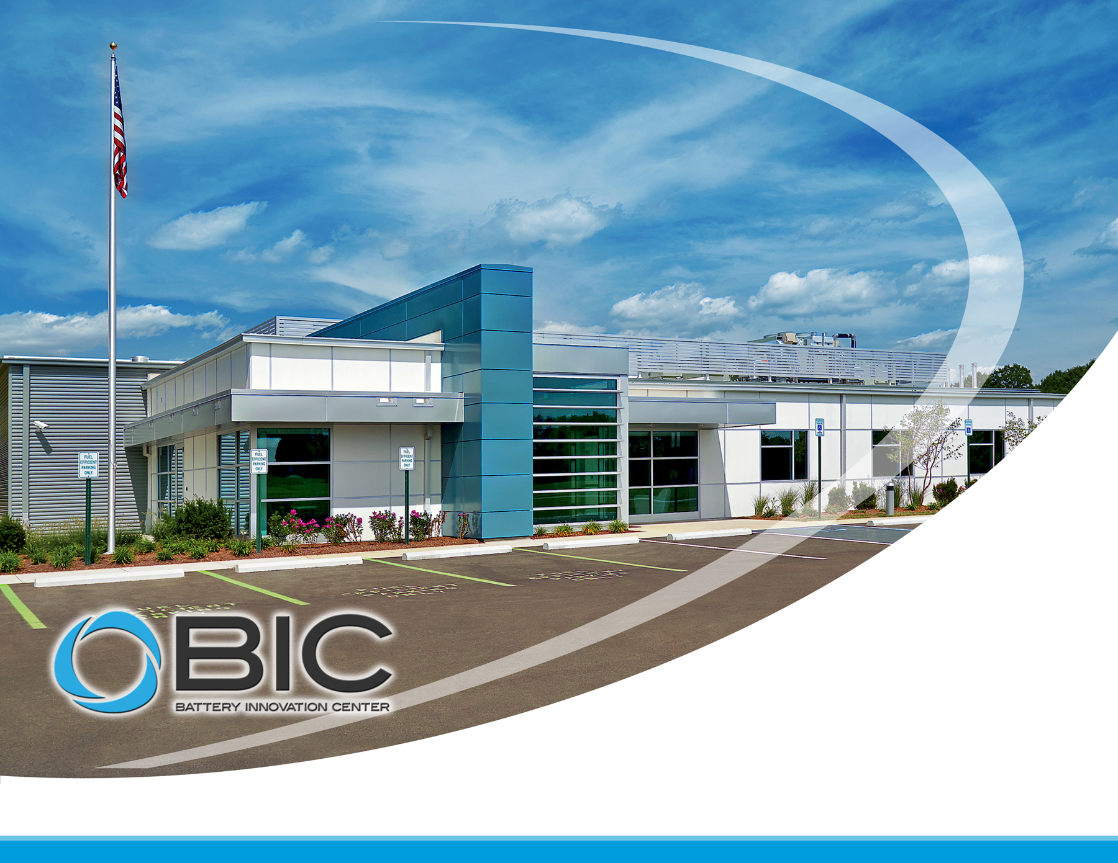
2022 Overview: Japan-Northeast Indiana Summit
“Leading the Charge for Innovation” v1.1

Slide 54

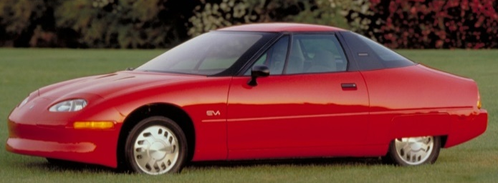
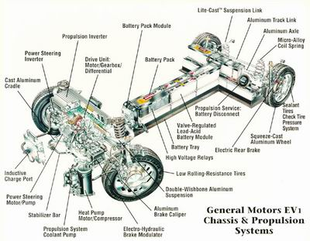
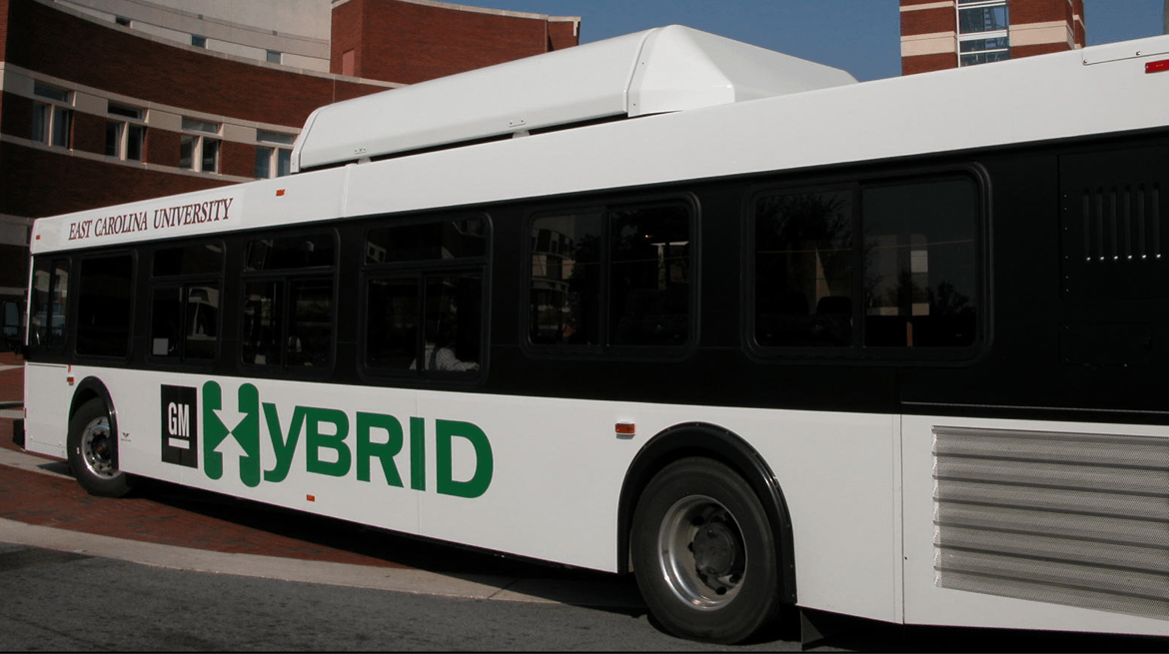
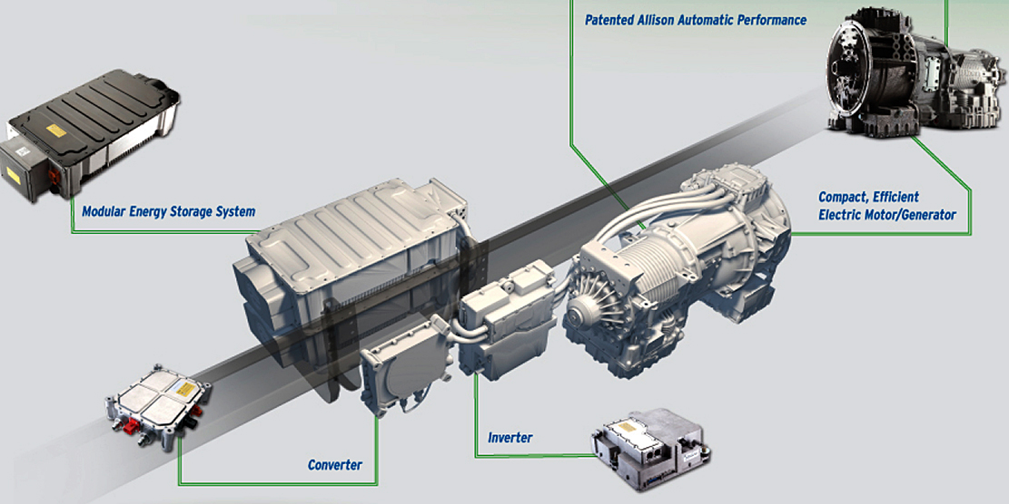
Indiana – Advanced Battery Bloodlines
Early 1900’s: Studebaker, Waverly Electric, Anderson Carriage Mfg and Milburn Electric (among several others)
1990’s: GM & Delphi advanced drivetrain R&D in Indianapolis
- earliest application of Li-ion technology to autos
- batteries for EV1 designed and built in Indianapolis
NSWC Crane established DOD’s largest, full-spectrum power system facility (131,000 ft²)
Early
2000’s: BAE & Allison develop hybrid drivetrain for buses
Delphi spins out dedicated LiB company, EnerDel
Former Delphi employees move to Altairnano to support LTO R&D
Cummins begins LiB R&D directed to genset applications
Energy Systems Network formed in 2009 to advance sector
Johnson Controls Battery Development facility
2010+: Various advanced drivetrain companies created
- Bright/Echo, Carbon Motors, THINK.
Several microgrid or stationary LiB companies developed
- GoElectric, MES, Indy Power Systems, etc.
ESN spearheads innovative programs
- Project PlugIN, Blue Indy, Vision Fleet, Duke Microgrid
Battery Innovation Center formed
Duke invests in microgrid testbed
AES/IPL announce 20MW storage project in Indy

Slide 55
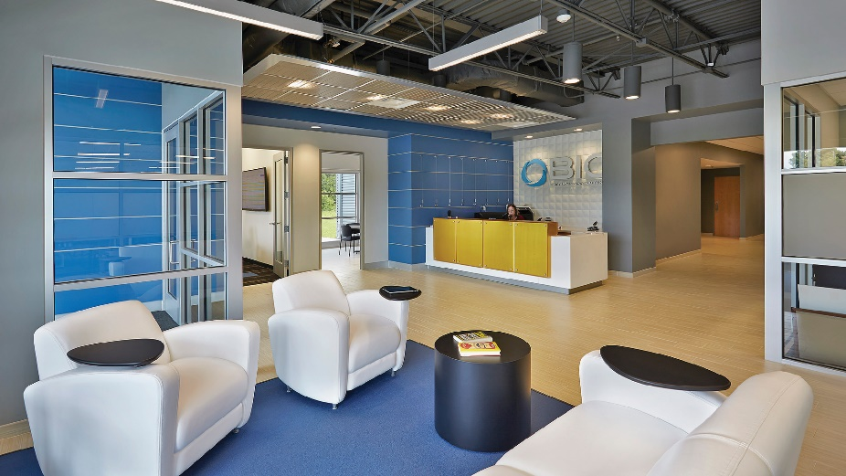
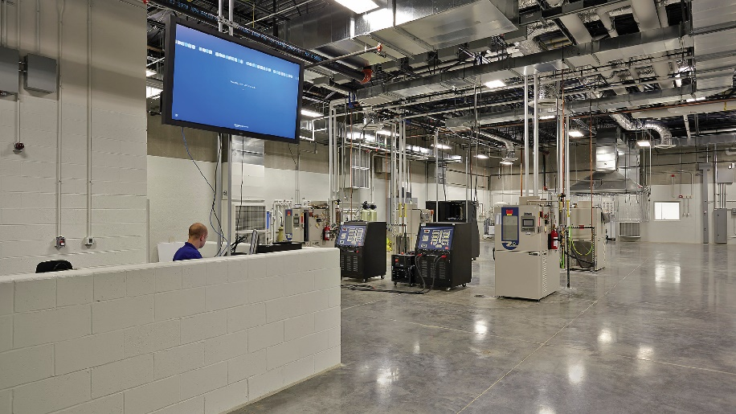

Mission
Rapidly develop, test, and help commercialize next generation energy systems that are safe, reliable, and lower-cost with partners from Industry, DoD/DoE, and Academia in a unique non-profit, public-private environment.
Distinguishing Features
Catalyze technologies by reducing long, expensive innovation-to-commercialization development cycle
Do not hold patent rights, reducing concerns to jointly develop technology
IP-secure, U.S. ITAR facility generating reliable data using leading techniques and equipment
Core Capabilities
Advanced Cell Manufacturing
  Materials processing to electrochemical testing
Testing, Evaluation, and Certification
  Cells, Modules, Small/Large Pack, and Containerized
  AC/DC Microgrid and Cybersecurity
R&D, Applied Services and Technical Advisory
Accredited Training and Short Courses

Slide 56
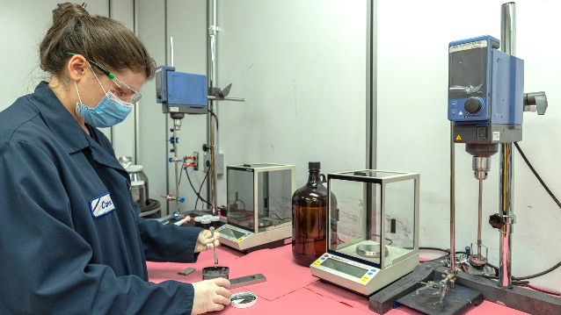
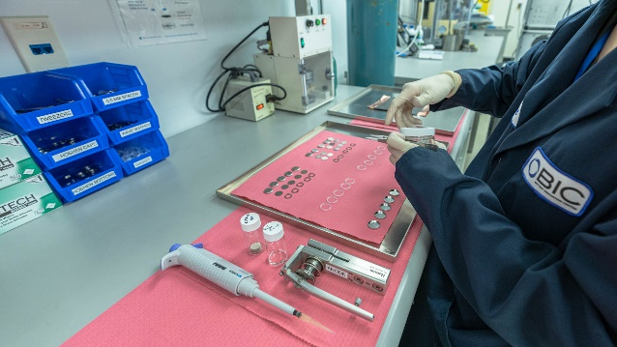
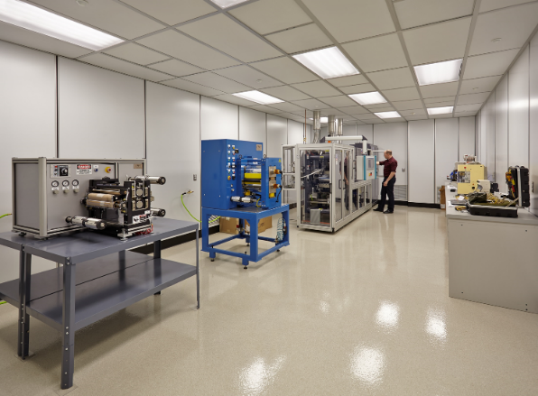
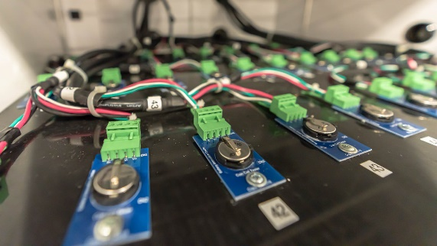
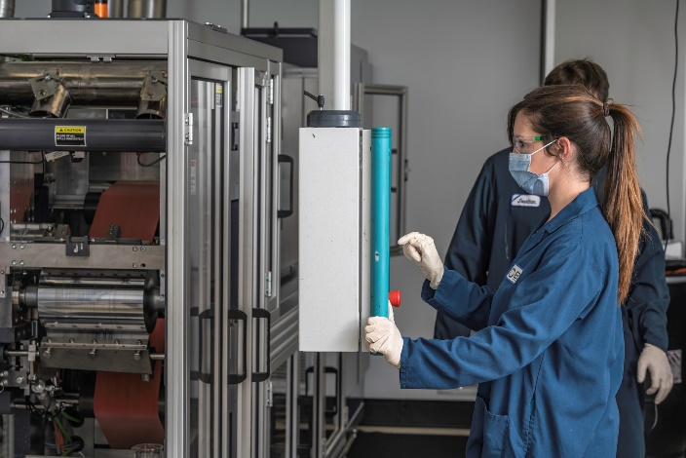
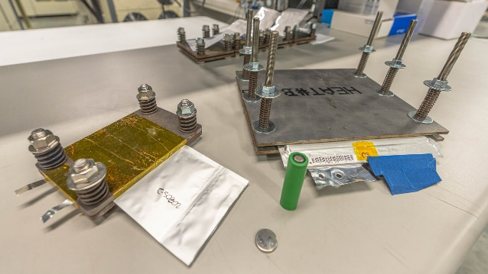
Advanced Cell Manufacturing
Low Volume Cell and Pack Production
<1% Relative Humidity/10K Class Dry Rooms
Commercial quality cell manufacturing equipment
  Cylindrical, Pouch, Prismatic, and Coin-cells
Proof-of-Commercialization expertise
Material and Process R&D
Novel use of industry-leading materials and technologies
Small batch mix and coat capabilities
Direct partnerships with industry suppliers
Factory demo center for equipment OEMs
Incubation location for Startups and Spin-Outs

Slide 57
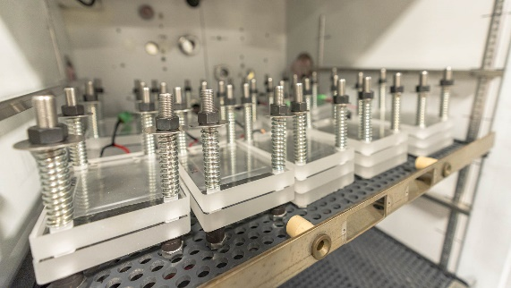
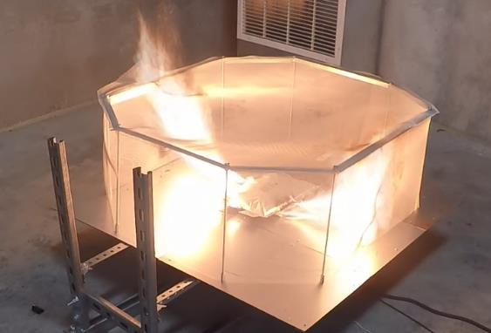

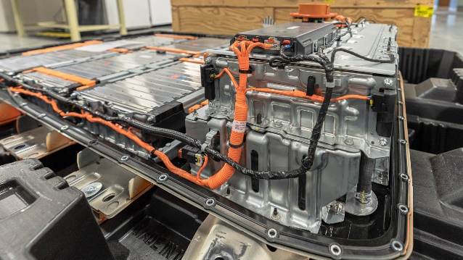
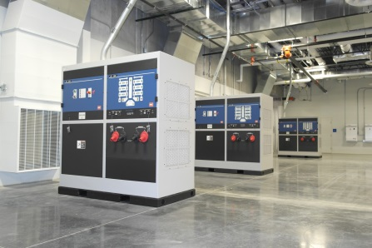
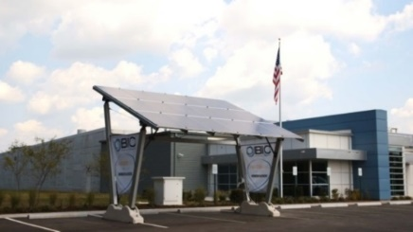
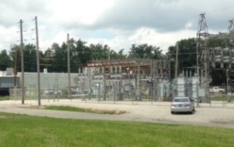
Testing, Evaluation, and Certification
Battery Testing and Validation
From single cells through to full systems
  Large format and outdoor testing capabilities
Environmental, Hazards, and Safety
Crush, Propagation, Drop, External Fire, and more
UL, MIL, UN-DOT, SAE, IEEE standards
Comparative and Competitive Analysis
UL B.E.S.T. Center
Micro-Grid and V2G Testing
Integrated solar and wind renewables
Plug-n-Play with various ESSs, inverters, PCSs
  AC utility-scale grid simulators (180kW+ scalable)
  >6MW of available power with net metering (MISO High Voltage Node) agreement
Cybersecurity Program/Hackathons
Open FMB and MESA
500Kw Vehicle to Grid

Slide 58
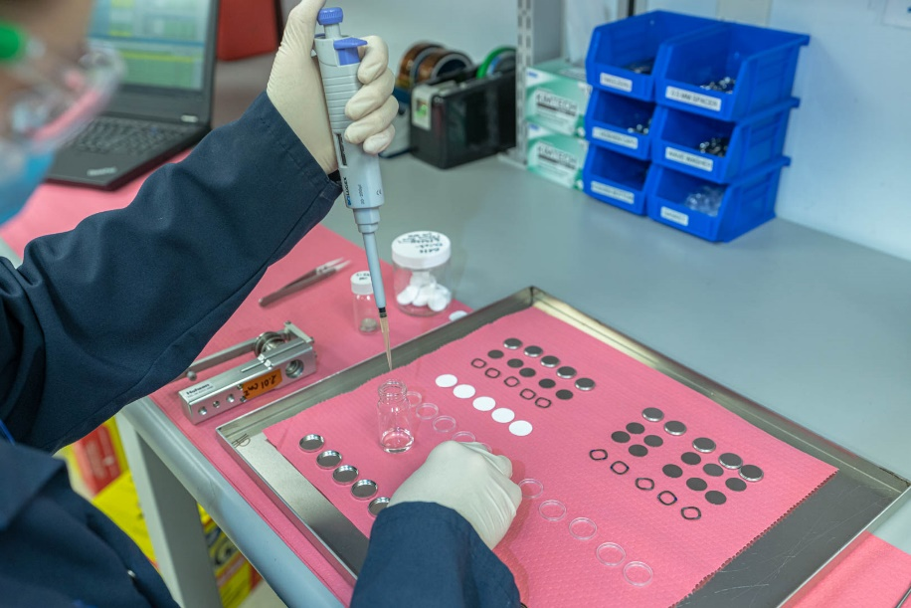
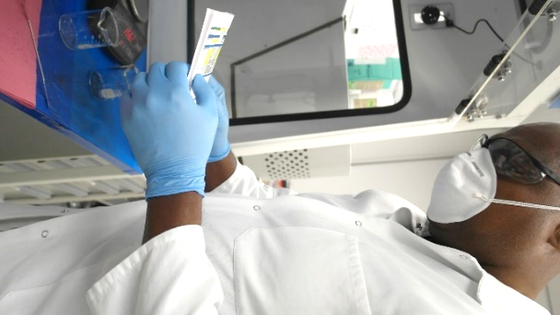

Research and Development
Standards and Materials Development
  In-Process consulting
  Internal capabilities expansion
  Next process Quality and Assurance
  Technology road mapping
  Exploration (ex. Solid State, Additive, Thermals)
Novel Labs
  Slurry recipe development & mixing
  Electrode casting
  Forensics and structure analysis
  Discovery opportunities

Slide 59
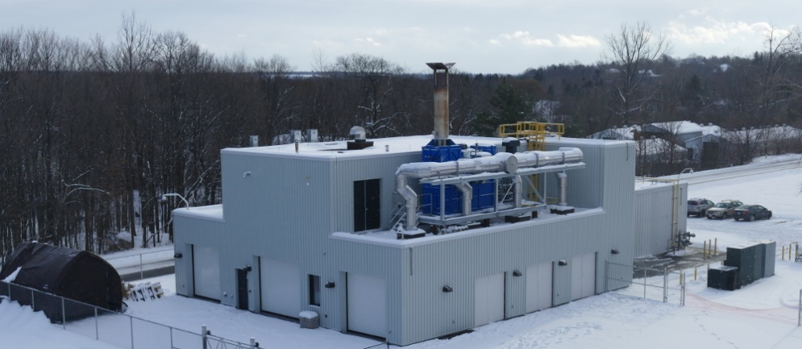
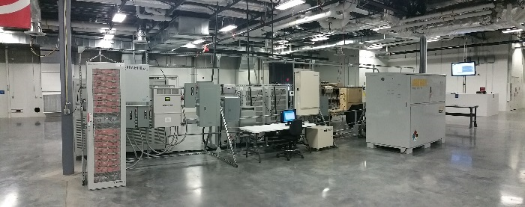
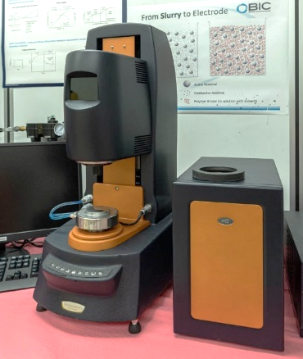
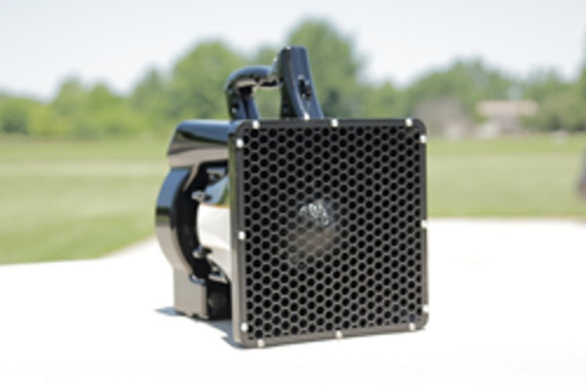
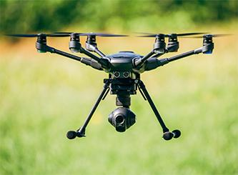
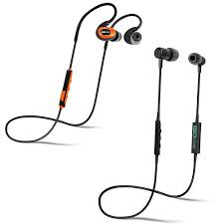
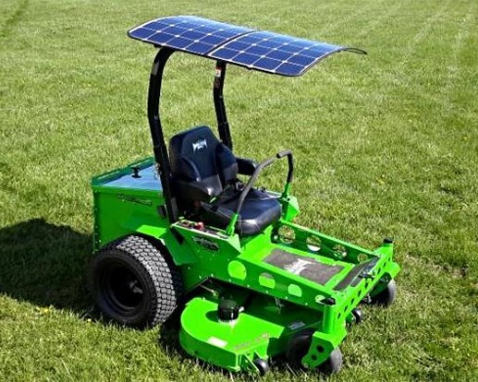
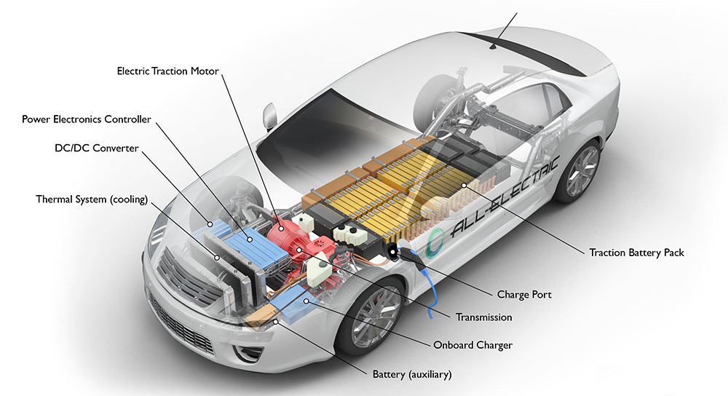
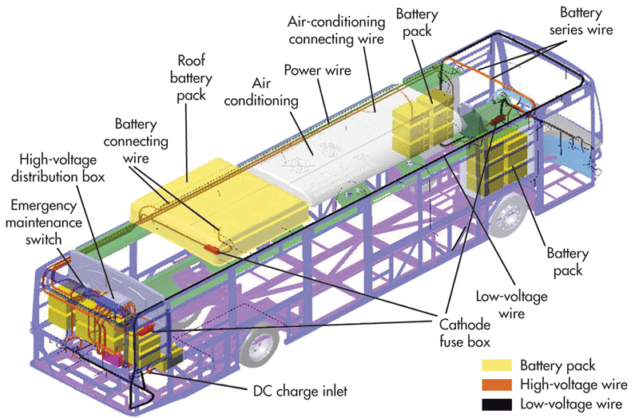
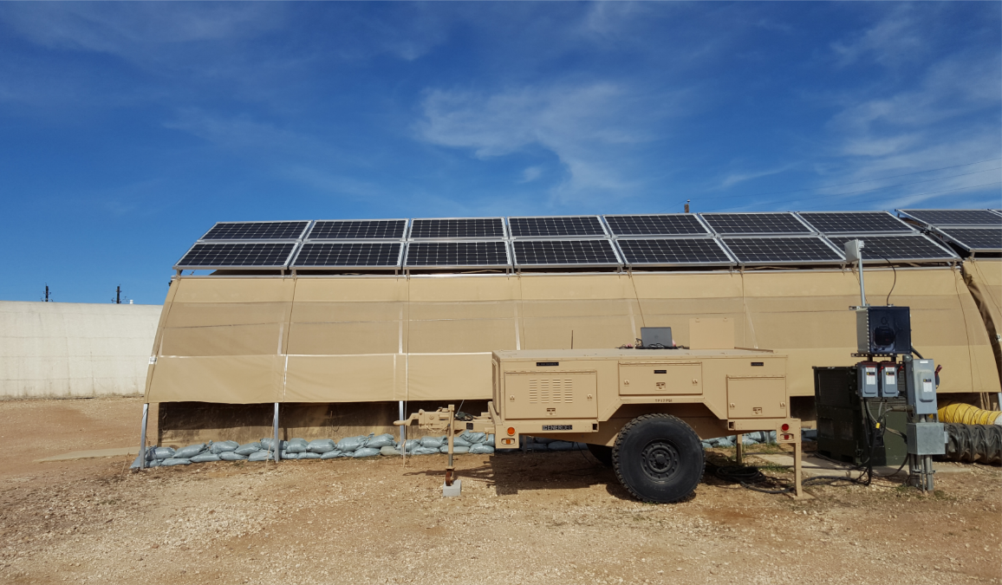
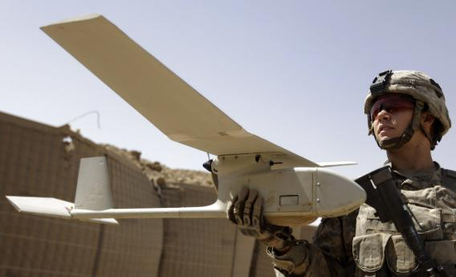
Applied Services and Technical Advisory
Expert Feedback and Analysis
  Facility Processes, Safety, Auditing, and Design
  Equipment and Capabilities
  Cell, Module, Pack, and System Design
  Battery Management Systems
  Vendor management and support
  Handling and Transportation
  Battery Second Use and Remanufacturing
  EV/PHEV, Consumer/IoT, Medical, Military, and Grid
Competitive Analysis
  Manufacturing & Test Equipment and Software
  Battery Components to System Operations
  Cell Dissection and Lab Analysis

Slide 60
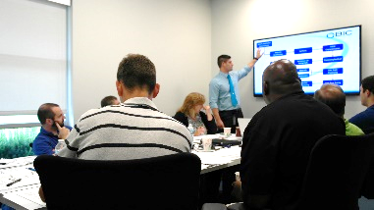
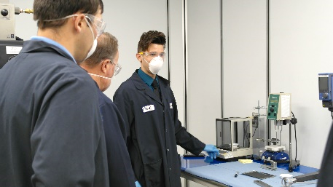
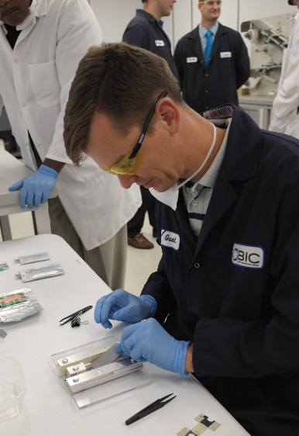


Accredited Training and Short Courses
  Battery Energy Storage Short Course (CEU)
    Industry leading experts teaching 3-4 Day Sessions
    Course Outline: Chemistry, Fabrication Development Processes, BMS, Module/Pack/System Design, Manufacturing, Validation/T&E, Cybersecurity, Second Life, Standards, and other key areas!
    Hands-On and Virtual Available
  AC/DC HV Fundamentals Course (CEU Credits)
  Energy Storage Technologies Executive Workshop
    Understanding, risk, and opportunities at leadership level
  On-Site and Remote Training
    Customized per client interest
    Individual modules including hands on practical application
CEU’s accredited by:

Slide 61

Indiana EV Products Commission
Purpose Of The Commission
Governor Holcomb signed House Bill 1168 into law during the 2021 legislative session, establishing the Electric Vehicle Product Commission. The 10-member commission is comprised of legislative representatives and industry leader who are tasked with:
Evaluating the inventory of existing electric vehicle product facilities and production capability.
Evaluate the inventory of skilled and nonskilled workers in the electric vehicle product industry.
Evaluate opportunities and needs for training within the electric vehicle product industry.
Determine if training centers promoting careers in the electric vehicle product industry should be created or transitioned from traditional automotive industry training centers.
Identify existing manufacturing competencies within the traditional automotive industry and determine how the existing competencies could be leveraged to increase the production of electric vehicles.
Identify and evaluate opportunities for growth within the electric vehicle product industry.
Identify and document results from previous instances of retooling and transforming manufacturing facilities in the automotive industry.
Identify opportunities for research and development within the electric vehicle product industry.
www.iedc.in.gov/program/electric-vehicle-product-commission/overview

Slide 62
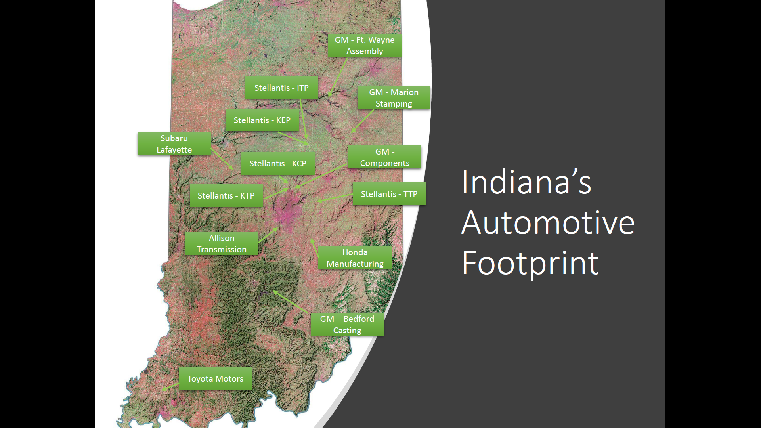

Slide 63
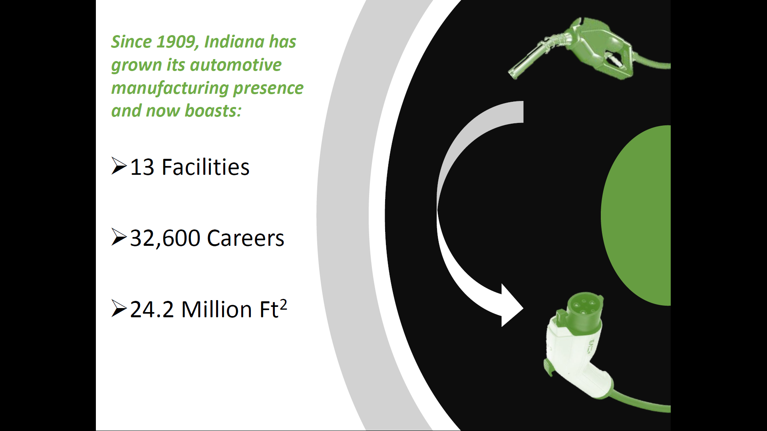

Slide 64
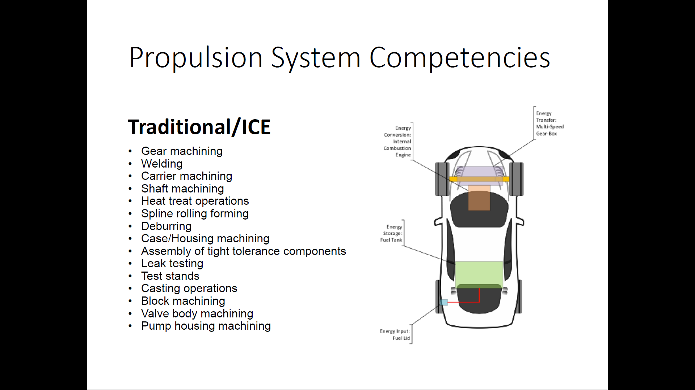

Slide 65
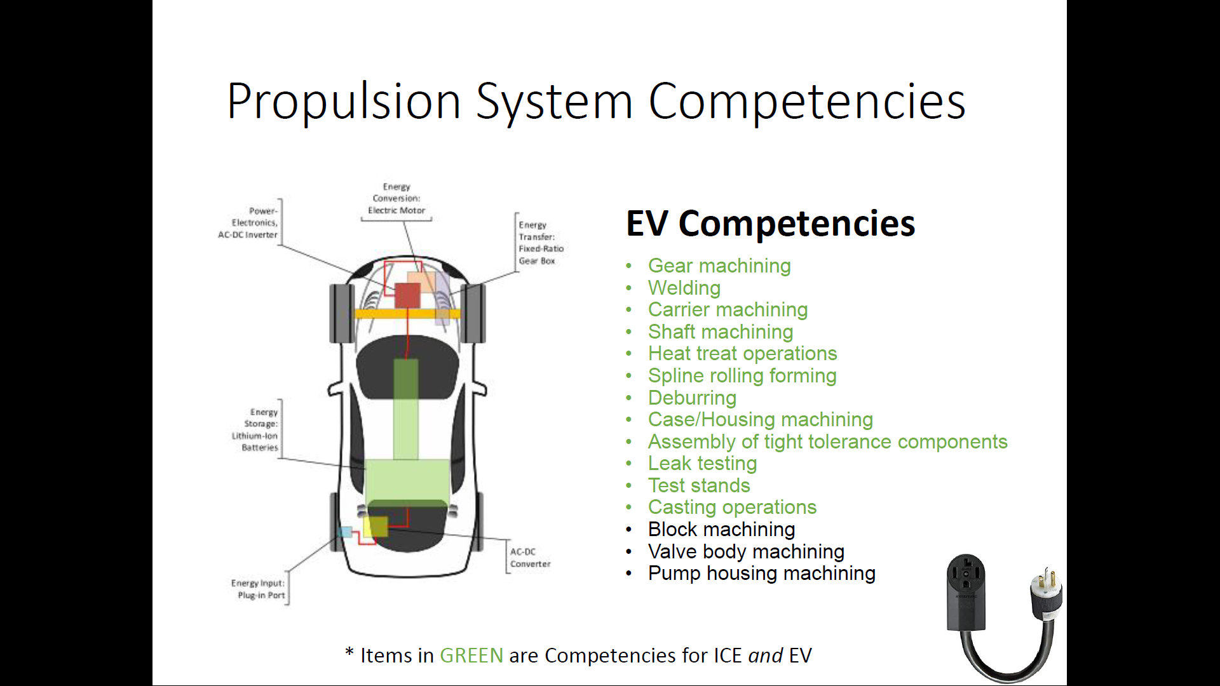

Slide 66


Slide 67


Slide 68


Slide 69




































































































Thank You!
Find Out More @ www.BICIndiana.com
TEN
NINE
TECH
ChargeCCCV

Slide 70


Slide 71
TEIJIN AUTOMOTIVE TECHNOLOGIES
Commitment to Indiana
2022

Slide 72


About me
Rick Doering, plant manager, Huntington, Indiana, operations
Owner, Alto Grado Food & Beverage Company, Fort Wayne
Nearly 30 years’ experience in automotive industry

Slide 73

Who is Teijin Automotive Technologies?
Teijin Automotive Technologies brings together the global expertise of Continental Structural Plastics, CSP Victall, Inapal, Benet Automotive and Teijin Automotive Center Europe to form the world leader in the formulation of advanced composites, and the design and manufacturing of components that enable our customers to build lighter, stronger, more eco-friendly vehicles.
More than 150 years’ combined materials and industry experience
Significant strategic global footprint:
  29 manufacturing facilities on three continents, including 4 advanced R&D centers
5,400 employees
More than $1 billion in global sales – projected to reach $1.5 billion by 2025
Innovation leader with numerous patents for materials, processes and products
  12 industry technology awards since 2015
2

Slide 74



Class A Body Panel Solutions – TCA Ultra Lite®
All Corvette body panels
Proprietary Class A composite material
Very lightweight
  >60% lighter that a steel design
  Competitive with aluminum in weight reduction
Teijin Automotive Technologies contributes 24 individual Class A body panels to the C8 Corvette Coupe and Convertible Programs

Slide 75






Product Capabilities
Our primary focus is on the transportation and industrial markets. We make both thermoset and thermoplastic components.
  Battery boxes/carriers
  Pickup boxes
  Class A body panels
  Marine/outboard motor covers
Structural components
Underbody components
Interior panels
Building, industrial components
Class A or external body panels and closures like doors, lift gates, trunk lids
Outboard motor cowls, chaps
Electric vehicle battery cases

Slide 76
Global Network
Asia
53companies
4,301employees
Americas,Others
41companies
5,061employees
Europe
23companies
2,799employees
Japan
52companies
9,654employees
Total
Number of Teijin Group Companies
169
Number of Teijin Group Employees
21,815
As of March 31,2022

Slide 77

Raw Material Development
Teijin Automotive Technologies is unique because we formulate our own materials, and then we mold it into products.
We are the largest compounder and manufacturer of composites in North America
Our global manufacturing and compounding footprint enables us to supply consistent materials and components to customers across North America, Europe and Asia – a capability no other composite manufacturer can provide.
Our proprietary materials formulations meet customer needs for weight reduction, unique styling, flame and thermal runaway resistance and corrosion resistance. Some of our formulations include:
  Award winning TCA Ultra Lite®
  Structural Ultra Lite™
  Award winning Sereebo®
  UV Stable SMC (for pickup boxes)
  Flame retardant SMC (for EV battery boxes)
  Carbon Fiber and Carbon Fiber SMC
  Low VOC SMCs
Teijin is the world’s second largest producer of carbon fiber.

Slide 78


GMC Sierra Denali
Sereebo (GMC CarbonPro) – Pickup Box
Industry-first carbon fiber composite pickup box

Slide 79

May 2016 Groundbreaking
$33 million investment
130,000 square foot addition to existing building
160 jobs

Slide 80


May 2022 Groundbreaking
$110 million investment
164,000 square-foot facility to house top-coat paint line, assembly area
Up to 225 jobs

Slide 81

ありがとうございました
(Thank you!)

Slide 82



Slide 83
INOVEC

Slide 84





Slide 85


Slide 86


Indiana is the perfect location for INOVEC
+ Fort Wayne, Indiana is located in the center of top-tier universities, high-volume manufacturing, and the biggest players in the off-highway industry
+ The region has an experienced work-force and
infrastructure to support manufacturing
U.S. Off-highway Electric Vehicle Market
18
16
14
12
10
8
6
4
2
0
2020 2021 2022 2023 2024 2025 2026 2027 2028 2029 2030
Construction Agriculture Mining
+ Off-highway electric vehicle market is expected to grow at 31.7% CAGR between now and 2030
➔ Growth of the entire supply chain is needed to support explosive growth
Source: Grandview Research

Slide 87


Slide 88


Slide 89













INOVEC will improve feedback experience for suppliers
Text
Communication level
Market Response level
End- user
OEMs
T-1
T-2
T...
- OEMs have no incentive to share plans with T-1‘s until it is absolutely necessary or they risk losing competitive advantage
Awarenes
Increases awareness
- At each stage, valuable feedback is lost and only the bare minimum is communicated, leaving suppliers underinformed
Reduces time
End-User OEM
- INOVEC can provide direct lines of communication between the end-user and down-tier suppliers to fill knowledge gaps
Supplier with
INOVEC
Supplier
Time

Slide 90







Suppliers go through the change curve
Unaware Uncertain
Unstoppable
Successful changes
Performance/ Motivation
and excited for future potential
Possible innovations
Unaware of opportunities
Companies getting aware of huge potential
Difficulties and uncertainty
Understanding meaning of changes
Time INOVEC helps these companies with business development
and building up the industry
INOVEC needs to convince them there is an opportunity before assisting in the solution
INOVEC provides “guide rails” that make innovation more attractive and actionable

Slide 91
Unaware Companies
+These companies are focused on business as usual
+They may have a niche market right now, but have no plans
to modernize or prepare for a new industry
+Unaware companies are used to having their finger on the pulse of their industry
INOVEC Engagement
Value to INOVEC
Description
Challenges:
+Unaware companies are not going to reach out to INOVEC because they do not see the potential opportunities
+They have invested a lot of money into fixed production capacity that may be difficult to repurpose
+Upper management is resistant to change and unwilling to spend more money
Value to ecosystem
There is nothing to offer others at this stage, but their conversion is critical in the long run
Company’s Perception
Potential Impact of INOVEC
+These companies may be aware that something is happening, but they don’t think they can be a part of it and don’t want to get involved in electrification
+They are waiting for things to get back to normal
+They are unaware of opportunities that would be complementary to core business and easy to capitalize on
+These companies likely believe their market position is unchallenged because there is a high barrier to entry into their market due to high CAPEX equipment
Converting these companies will have a large impact on the Indiana region and OHV industry
Value Proposition:
+INOVEC needs to convince them there is a problem before assisting in the solution
+Primary efforts focused on
awareness and recruitment
Effort to Support
High internal resistance will make engagement very difficult and time-consuming

Slide 92
Uncertain Companies
+These companies are trying to make changes
+They are overwhelmed by their outlook on the market
+At this point, these companies “know what they don’t know”, but there are not many resources to help them
INOVEC Engagement
Value to INOVEC
Description
Challenges:
+Each company is going to have its own needs based on their existing equipment and process
+These companies are going to struggle prioritizing change with business as usual
+Any early failures may dissuade
the company from continuing
Value to ecosystem
These companies may be willing to work with other suppliers that are not direct competitors
Company’s Perception
Potential Impact of INOVEC
+These companies see innovations in products, processes and business models happening all around them
+They are aware of the huge potential, but are unsure of how to capitalize on industry changes
+These companies have difficulties balancing change with innovation and find it impossible to prioritize
+Fear and excitement about changes is uncomfortable for decision makers, who see certain failure if they do nothing and likely failure if they take the wrong path
Value Proposition:
+INOVEC can help these companies identify resources
+INOVEC provides the “guide rails” that makes innovation more attractive
+Primary efforts focused on education and identifying solutions
These companies are like unaware companies, but are easier to support
Effort to Support
These companies are willing, but providing the correct help will be the primary challenge

Slide 93
Unstoppable Companies
+These companies have been making successful changes
and are emerging as winners in their markets
+They are eager for change to accelerate and are excited about the future potential
INOVEC Engagement
Value to INOVEC
Description
Challenges:
+These companies feel good about their level of success and may not be interested in sharing knowledge or helping struggling suppliers
+INOVEC needs to identify ways to offer value initially to get value back
Value to ecosystem
These companies may be willing to work with other suppliers that are not direct competitors
Company’s Perception
Potential Impact of INOVEC
+These companies have external challenges with interoperability and education of others.
+They have had success and understand the roadmap for making sweeping changes that work with and augment their current business
+Most fear is gone from these companies and has been replaced with excitement about the opportunities that are presenting themselves
+Frustrations about the lack of support from other suppliers and
lack of interoperability is the main hurdle
Value Proposition:
+INOVEC can help these companies with business development
+Primary efforts focused on
building up the industry
Growth in the industry as a whole and more capable partners will alleviate largest challenges.
Effort to Support
Very little direct help will be required to support these companies

Slide 94


Slide 95


Slide 96


Slide 97


Slide 98


Slide 99


Slide 100


Slide 101







Next Steps to define INOVEC‘s contribution
Technology Pillars
Contextualize the technology pillars by adding depth and boundaries for each pillar
Define the assets and services that are needed to carry the technology pillars
Identify interfaces between technology pillars and external partner network
Stakeholders
State the central problem that INOVEC is going to fix for each stakeholder
Define relationship of OEM‘s to
INOVEC
Continue to source feedback based on understanding of technology pillars
T t
ex

Slide 102











The pre-feasibility study will clarify the vision for INOVEC
Phase 1a: Proof of Concept – Pre-Feasibility
WP1: Analysis and Design
WP2: Technology Pillars (TP)
WP3: Summary
WP 1.1: Initial Analysis
+ Create deep understanding of industry needs
+ Derive purpose of INOVEC
+ Evaluate current situation, ideas, understanding and material
WP 1.2: Stakeholder Mapping
+ Interview existing stakeholder
+ Map out stakeholders(incl. interests, competencies, involvement, boundaries, etc.)
WP 2.1: Selection of TP
+ Summarize finding in easy- to-read report
+ Create comprehensive
slide deck
+ Recommend next steps and initial roadmap for feasibility study
+ Create material to use for
external communication
+ Contextualize TPs to identified market needs
+ Validation or negation of identified technology pillars
WP 2.2: Depth of TP
+ Identify initial setting of technology depth for each TP
+ Outline content of each TP
+ Define boundaries and names for each TP
WP 2.3: Features of TP
WP 1.3: Vision and Mission
+ Create a clear vision for INOVEC
+ “What it isn’t” assessment
+ Define streamlined, crystallized mission statement
+ Identify must-have features, ie.
Services and/or assets
+ Identify interfaces of TPs to other
TPs and partner network
Results of WP 1 will be affected by insights gained during WP 2 and may require revision

Slide 103
INOVEC

Slide 104


Slide 105


Slide 106


