Slide 1
Session: 4 of 9
Date: January 18, 2024
Time: 9:00 am to 4:00 pm
Location: Ford Meter Box
Notes:
Welcome back! I hope holiday season is treating you well.
Say your name and favorite thing you are looking towards for 2024!
Any celebrations– promotions, babies, houses, etc?

Slide 2
CORE SPONSORS:
LUNCH SPONSORS:
SCHOLARSHIP SPONSORS:
Notes:
Core Sponsors
Beacon Credit Union – welcome to Chandra & Madyson – last year David & Chris from BCU
City of Wabash – donated their spot so one of you received
Wabash County – welcome to Chrissy from the Deputy Recorder
Lunch Sponsors
Duke Energy
Edward Jones
Josiah Whites
Heartland Career Center
NIPSCO
Ruoff Mortgage
Town of North Manchester – a few North Manchester residents – Jacquelin who lives outside of NM and Kathy Carney who works at Intertech in NM
Real Alloy- welcome to Jerome
Scholarship Sponsors – congrats to the participants who received scholarships
Downtown Wabash, Inc- welcome to Adrianna
City of Wabash
Hoosier Jiffy Print
GWC

Slide 3
Today’s Lunch Sponsor
Notes:
I really like food so I try make sure we feed you really well during this program!
Lunch will be from Jalapeno Baja – Chicken, steak, Mexican rice, hot/mild salsa, pinto beans, pico de gallo, guacamole, chips, tortilla.
Coffee, tea, and other drink refreshments will be provided all day.
Sodas and waters are also available.

Slide 4
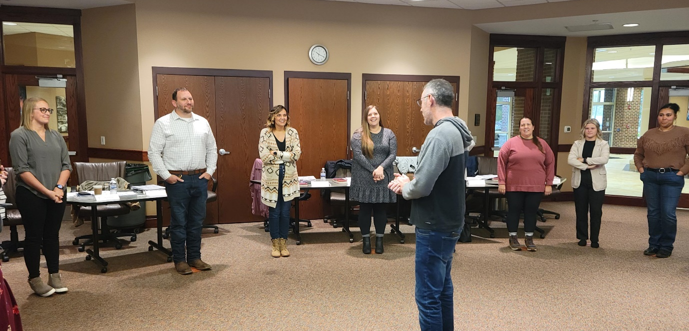
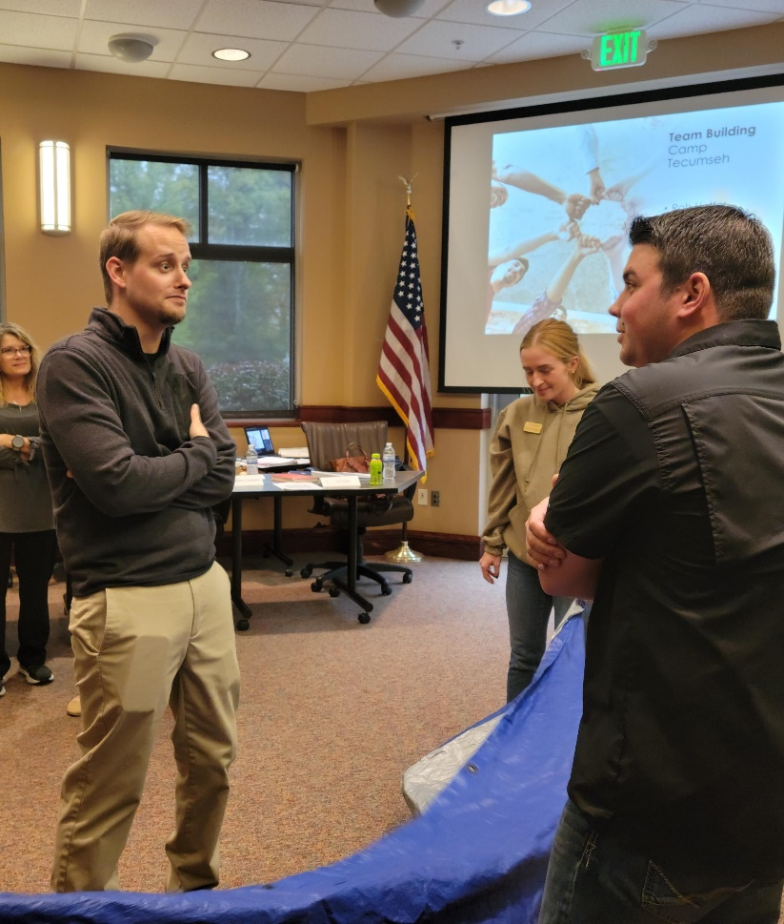
Today’s Agenda
Session Overview
Host Tour
Cultivating Self as Leader
Lunch
StrengthsFinder Session 2
Notes:
Lunch will be from Jalapeno Baja – Chicken, steak, Mexican rice, hot/mild salsa, pinto beans, pico de gallo, guacamole, chips, tortilla.

Slide 5
Housing Keeping Items
Restrooms
WiFi Password
Refreshments
Smoking Policy
Notes:
Smoking Policy: We are a tobacco free facility but have designated smoking areas available. This includes all tobacco products and e-cigarettes.

Slide 6
Host Tour
Notes:
I really like food so I try make sure we feed you really well during this program!
Lunch will be from Jalapeno Baja – Chicken, steak, Mexican rice, hot/mild salsa, pinto beans, pico de gallo, guacamole, chips, tortilla.
Coffee, tea, and other drink refreshments will be provided all day.
Sodas and waters are also available.

Slide 7
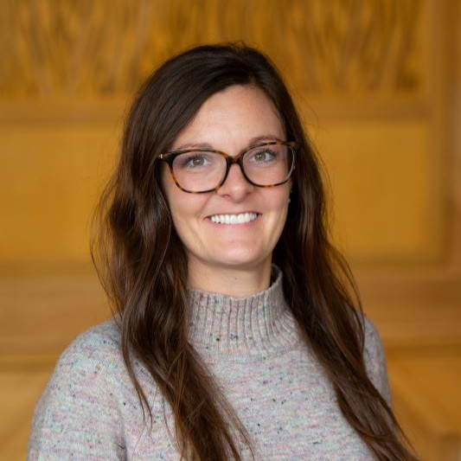
Indiana University Candace Murray (Rhodes), M.A.
Adjunct Professor, Communication, IU Kokomo
Academic Advisor, IU Online Undergraduate
Office of Online Education

Slide 8
Cultivating Self as Leader Leadership Microcredentials - GWC
Candace Murray (Rhodes) M.A.
Adjunct Professor Communication; Academic Advisor IU
candacer@iu.edu

Slide 9
Analyze self in interpersonal theory and skills such as non-verbal communication, perception, language and cultural influence.
Overview of Interpersonal communication
Listening skills
Perception
Perception-Checking Practice
Pillow Method
Non-verbal communication
types
Impact of Language
I/You/We language
Cultural Influence
What to expect:

Slide 10
1. What is Interpersonal Communication?

Slide 11
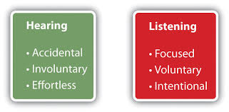
2. Listening Skills
Hearing is physiological
Listening is psychological
Also Mindless Listening (superficial) vs. Mindful Listening (careful thought & attention)
Reference: Adler, R. B., Proctor II, R. F. & Manning, J. (2022)

Slide 12
What is Effective Listening?
First: let’s see where we are with current skills
Complete Listening Skills quiz https://www.mindtools.com/pages/article/listening-quiz.htm
Reference: Adler, R. B., Proctor II, R. F. & Manning, J. (2022)

Slide 13
Elements in the Listening Process
Hearing – physiological process
Attending – part of the process of selection from Ch. 4 Perception
Understanding – making sense of a message
Listening Fidelity – congruence between what a listener understands and what the message sender was attempting to communicate
Responding – giving observable feedback to the speaker (NON-VERBAL communication!!!!); remember listening is an active process
Remembering – the ability to recall information
Reference: Adler, R. B., Proctor II, R. F. & Manning, J. (2022)

Slide 14
Challenges of Listening
How do we become better listeners?!?!
STEP #1: acknowledge areas that need improvement
So, in your notebook, be prepared to write:
STEP #1 – where do you find yourself needing improvement (we will review some areas in the next slide)
STEP #2 – write down 1 way you can begin to improve this/these area(s)
Reference: Adler, R. B., Proctor II, R. F. & Manning, J. (2022)

Slide 15
Challenges of Listening
INEFFECTIVE LISTENING
Pseudolistening
Stage-hogging, or ‘conversational narcissist’
Selective listening – only listening to what you want to hear
Insulated listening – avoiding topics you don’t want to hear
Defensive listening
Ambushing (ex: cross-examining prosecuting attorney)
Insensitive listening
WHY WE DON’T LISTEN BETTER
Message overload
Pre-occupation
Rapid Thought
Effort – listening is hard work!!!
External Noise
Faulty Assumptions
Lack of Apparent Advantages
Lack of Training
Hearing problems
Reference: Adler, R. B., Proctor II, R. F. & Manning, J. (2022)

Slide 16
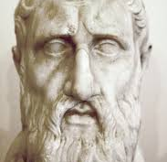
Meeting the Challenge of Listening (more effectively??!!)
Talk less
W.A.I.T. (why am I talking)
Zeno of Citium (philosopher from Cyprus)
Get Rid of Distractions
Don’t judge prematurely
Listen first. Make sure you understand.
Then evaluate.
Look for Key Ideas
Reference: Adler, R. B., Proctor II, R. F. & Manning, J. (2022)

Slide 17
Case Study work
Worksheet and work in groups: Assessing Listening Situations
Reference: Adler, R. B. & Proctor II, R. F. (2015)

Slide 18
Types of Listening Responses
7 General Areas:
1. Prompting: involves using silences and brief statements of encouragement to draw others out.
“Prompting will work best when it’s done sincerely – eye contact, posture, facial expression, tone of voice have to show that you are concerned with the other person’s problem
2. Questioning: asking for information; “the most popular piece of language”
Sincere questions – aim is to understand others
Counterfeit questions – aim is to send a message, not receive one
Questions that trap the speaker
Questions that carry hidden agendas
Questions that seek “correct” answers
Questions based on unchecked assumptions
Reference: Adler, R. B., Proctor II, R. F. & Manning, J. (2022)

Slide 19
Types of Listening Responses
3. Paraphrasing – statements that reword the listener’s interpretation of a message (factual information &/or personal information)
Examples:
“So what I hear you are saying is…”
“Let me make sure I understand what you are saying…”
“Let me see if I’ve got this right…”
Benefits of Using Paraphrasing:
Could be a tool for helping others
Encourages the problem holder to discuss the matter further
Helps the problem holder to sort out the problem
Helpful when:
The issue is complex enough
Do you have the necessary time and concern?
Can you withhold judgment?
Is your paraphrasing in proportion to other responses?
Reference: Adler, R. B., Proctor II, R. F. & Manning, J. (2022)

Slide 20
Types of Listening Responses (cont.)
4. Supporting – reveals a listener’s solidarity with the speaker’s situation; “expressions of care, concern, affection, and interest, especially during times of stress or upset.”
Types of Support:
Empathizing
Agreement
Offers to help
Praise
Reassurance
Reference: Adler, R. B., Proctor II, R. F. & Manning, J. (2022)

Slide 21
Types of Listening Responses (cont.)
Supporting (cont.)
When you should not use supportive language/listening when:
You deny others the right to their feelings
Minimize the significance of the situation
Focus on the ‘then and there’ rather than ‘here and now’
Cast judgment
Focus on yourself
Defend yourself
Guidelines for Effective Support
Recognize that you can support another person’s struggles without approving of his or her decisions
Monitor the other person’s reaction to your support
Realize that support may not always be welcome
Make sure you’re ready for the consequences
Reference: Adler, R. B., Proctor II, R. F. & Manning, J. (2022)

Slide 22
Types of Listening Responses (cont.)
5. Analyzing – the listener offers an interpretation of a speaker’s message
Can be helpful, but also can create more problems
Check your motives!!!
6. Advising – to help by offering a solution
Guidelines:
Is the advice needed?
Is the advice wanted?
Is the advice given in the right sequence? (listen first, then advise)
Is the advice coming from an expert?
Is the advisor a close and trusted person?
Is the advice offered in a sensitive, face-saving manner?
Reference: Adler, R. B., Proctor II, R. F. & Manning, J. (2022)

Slide 23
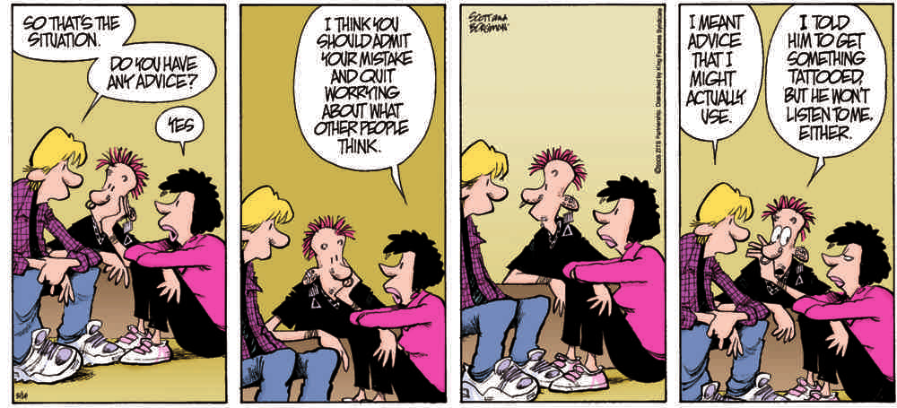
Types of Listening Responses (cont.)
7. Judging – evaluates the sender’s thoughts or behaviors in some way (could be favorable or unfavorable)
Note: even constructive criticism runs the risk of arousing defensiveness
Best Chance of Being Received:
The person with the problem has requested an evaluation from you
The intent of your judgment has genuine constructive thoughts and not designed as a put-down.
Perhaps a good questions is: “Are you looking for my advice, or do you just want a listening ear right now?”
Reference: Adler, R. B., Proctor II, R. F. & Manning, J. (2022)

Slide 24
Case Study work
Chris and Sam have been friends since elementary school and now are in their 30’s. Chris has been happily married for 10 years. Sam has been engaged 4 times, and each time has broken it off as the marriage date approaches. Sam has just announced another engagement.
Reference: Adler, R. B. & Proctor II, R. F. (2015)

Slide 25
Case Study work
What are likely barriers that would prevent Chris from listening effectively?
What types of ineffective listening are likely to occur if Chris doesn’t carefully consider his listening options?
What listening style(s) could Larry use that would be most helpful to Sam? Why? Construct a response for Chris using that style.
Imagine that the friends described here are both women// both men. Would your responses to the preceding questions change? How? Be specific.
Reference: Adler, R. B. & Proctor II, R. F. (2015)

Slide 26
Assignment after session:
Complete Activity over next week to identify listening blind spots.
“Put Down the Phone Paper”
Incorporate blindspot/ways to improve activity from this lecture
Document a clear understanding of one’s own strengths and weaknesses in areas of listening effectively, and interpersonal skills.
Re: reflect on your listening inventory taken at the beginning of the lecture

Slide 27
Perception (from Latin perceptio 'gathering, receiving') is the organization, identification, and interpretation of sensory information in order to represent and understand the presented information or environment (Wikipedia, https://en.wikipedia.org/wiki/Perception retrieved Jan. 15, 2024)
Activity: https://creducation.net/resources/perception_checking/Understanding_Perception_Differences_OCDRM.pdf
3. What is Perception: noun
Reference: Adler, R. B., Proctor II, R. F. & Manning, J. (2022)

Slide 28
The Perception Process
Selection – what stimuli to pay attention to and what to ignore
intense stimuli (larger, louder, brighter stands out), repetitious stimuli, or CONTRAST/change also stands out, motives also influence
Organization – arranging stimuli in a way that is meaningful
Perceptual schema – appearance, social roles interaction style, psychological traits, membership
Stereotyping – (when organizing schema loses touch with reality) exaggerated generalizations associated with a categorizing system
Interpretation – attaching meaning to sense data
Degree of involvement with the other person, personal experience, assumptions about human behavior, attitudes, expectations, knowledge, self-concept, relational satisfaction
Negotiation – sense-making between and among people as they influence one another’s perceptions and try to achieve a shared perspective
Narratives – exchange of stories that we use to describe our personal world
Reference: Adler, R. B., Proctor II, R. F. & Manning, J. (2022)

Slide 29
Influences on Perception
Access to Information
How to manage with social media
Physiological Influences
Age | gender | health & fatigue | biological cycles (morning or night person & hormones) | Food (enough and good food)
Senses
Psychological challenges
Cultural Differences
Cultural value of politeness, use of talking/silence
Sub-cultures and norms
Socioeconomic status
Social Roles
Gender Roles (sex vs. gender)
Occupational Roles – type of work you do influences or view of the world
Relational Roles
Romantic love | parent | sister/brother | friend
Reference: Adler, R. B., Proctor II, R. F. & Manning, J. (2022)

Slide 30
Common Tendencies in Perception
Attribution – to describe the process of explaining people’s behavior
We Judge Ourselves More Charitably Than We Judge Others
We Cling to First impressions
We Assume that Others are Similar to Us
We Are Influenced by our Expectations
We are Influenced by the Obvious
Reference: Adler, R. B., Proctor II, R. F. & Manning, J. (2022)

Slide 31
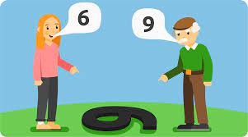
2 Ways to Help be more accurate in your Perception Making skills.
Perception Checking - 3 parts to help “you understand others accurately instead of assuming that your first interpretation is correct.” (pg. 124) Goal = mutual understanding
Pillow Method
Reference: Adler, R. B., Proctor II, R. F. & Manning, J. (2022)

Slide 32
Perception-Checking Practice
Elements of Perception Checking
A description of the behavior you noticed
At least two possible interpretations of the behavior
A request for clarification about how to interpret the behavior
Example:
“When you stomped out of the room and slammed the door, (behavior), I wasn’t sure whether you were mad at me (first interpretation) or just in a hurry (second interpretation). How did you feel (request for clarification).” (page 133)
Reference: Adler, R. B., Proctor II, R. F. & Manning, J. (2022)

Slide 33
2 Ways to Help be more accurate in your Perception Making skills.
Pillow Method – was named by the Japanese schoolchildren based on the fact that a problem has four sides and a middle, just like a pillow (Figure 4.3). As the following examples show, viewing an issue from each of these perspectives almost always leads to valuable insights—and in so doing enhances cognitive complexity - which helps in our Perception making skills
Method works to develop empathy (the ability to re-create another person’s perspective, to experience the world from the other’s point of view)
The experience becomes your own… you feel ___ with someone
Method also works to develop sympathy (you view the other person’s situation from your point of view.)
The experience you recognize what the other person is feeling… feeling ___ for someone
Reference: Adler, R. B., Proctor II, R. F. & Manning, J. (2022)

Slide 34
Pillow Method Practice FIGURE 4.3 PAGE 141
Reference: Adler, R. B., Proctor II, R. F. & Manning, J. (2022)

Slide 35
Case Study
Worksheet “4.2 Shifting Perspectives – Pillow Method”
Part I: identify a conflict or issue at work, write the background and answer the questions for each of the perspectives.
Part II: work with a partner to talk through your situation and the four positions, role-play; a few partnerships share with the group
Reference: Adler, R. B. & Proctor II, R. F. (2015)

Slide 36
Non-Verbal Communication: messages expressed by nonlinguistic means​… ‘communication without words’
Non-verbal Skills are Vital ​
For relationships |certain careers | and strong ‘emotional intelligence’​
All Behavior has communicative value​
Nonverbal Communication is primarily Relative​
Impression management | the type of relationship we have with others | conveys emotions​
​Nonverbal Communication can occur in mediated messages​
Use of emoticons | others…?​
Nonverbal Communication serves many functions​
Repeating (words and non-verbal reinforce) | complementing (non-verbals match the thoughts & emotions) | substituting | Accenting | Regulating | contradicting/mixed messages​
Nonverbal Communication offers deceptive cues​
Leakage – inadvertent signals of deception | facial expressions, pupil dilation, physiological response that cannot be controlled, speech patterns​
Nonverbal Communication is ambiguous​
4. Non-Verbal Communication
Reference: Adler, R. B., Proctor II, R. F. & Manning, J. (2022)

Slide 37
Types of Non-Verbal Communication
BODY MOVEMENT (Kinesics)
Body orientation – body, feet and head
Posture
Gestures
Face & Eyes
** Pause & Reflect**
Think about your current or future job… how do these types of non-verbal communication examples have the potential to impact positively/negatively?
Reference: Adler, R. B., Proctor II, R. F. & Manning, J. (2022)

Slide 38
Types of Non-Verbal Communication
VOICE
Paralanguage (describes non-verbal, vocal messages)
Intentional pause | Unintentional pause
TOUCH (haptics)
**Pause and Reflect**
Like most types of nonverbal behavior, touching is governed by cultural and social rules. If you were going to write a guidebook for visitors to Wabash/Indiana, what would you say are the ‘rules’ for these relationships:
An adult and a 5 year-old child
An adult and a 12 year-old child
Two good friends
Boss and employee
Reference: Adler, R. B., Proctor II, R. F. & Manning, J. (2022)

Slide 39
Types of Non-Verbal Communication
APPEARANCE
Physical attractiveness
Clothing
PHYSICAL SPACE (Proxemics)
Anthropologist Edward T. Hall describes 4 types of distances that most North Americans use in their everyday lives
Intimate distance – 0-18 inches
Personal distance – 18 inches to 4 ft.
Social distance – 4 – 12 feet
Public distance – 12 feet and beyond
** Pause & Reflect **
Think about your current or future job… how do these types of non-verbal communication examples have the potential to impact positively/negatively?
Reference: Adler, R. B., Proctor II, R. F. & Manning, J. (2022)

Slide 40
Types of Non-Verbal Communication
PHYSICAL ENVIRONMENT
What does your room/house/office space say about you?
TIME (Chronemics)
On time, ‘time is money’, or time is relative?
** Pause and Reflect **
Think about your current or future job… how do these types of non-verbal communication examples have the potential to impact positively/negatively?
Reference: Adler, R. B., Proctor II, R. F. & Manning, J. (2022)

Slide 41
How can we work help to clarify the issues of non-verbal communication?
Perception checking and Pillow talk method)
I/You/We language (next…)

Slide 42
5. What is Language?
Reference: https://www.slideshare.net/NirajanSilwal/interpersonal-communication-63287843

Slide 43
5. What is Language?
Reference: https://www.slideshare.net/NirajanSilwal/interpersonal-communication-63287843

Slide 44
Impact of Language
1. Naming and Identity
“Names shape the way others think of us, the way we view ourselves, and the way we act.” pg. 186
Nick names
Unique names
‘labels’ like ADHD, disabilities, LGBTQ+
2. Affiliation
“Communication researchers call the process of adapting one’s speech style to match that of others convergence.” pg. 188
“Communicators who want to set themselves apart from others adopt the strategy of divergence, speaking in a way that emphasizes their differences from others.” pg. 188
3. Power & Politeness
https://qz.com/896146/how-ikea-names-its-products-the-curious-taxonomy-behind-billy-poang-malm-kallax-and-rens/
Reference: Adler, R. B. & Proctor II, R. F. (2015)

Slide 45
“I”/ “You” / “We” Language
“I” Language – clearly identifies the speaker as the source of a message
Communicators who use “I” language accepts responsibility for a message
“You” Language – expresses a judgement of the other person; can be positive or negative
Ex: “You left this place a mess!” | “I don’t want to be responsible for all the cleaning in the apartment.”
Ex: “You didn’t keep your promise!”
“We” Language – implies that the issue is the concern and responsibility of both the speaker and receiver of a message.
Ex: “We need to figure out a budget that doesn’t bankrupt us.”
Ex: “I think we have a problem. We can’t seem to talk about your friends without fighting.”
Reference: Adler, R. B. & Proctor II, R. F. (2015)

Slide 46
Reference: Adler, R. B. & Proctor II, R. F. (2015)

Slide 47
Case Study – Partner work
Go back to your partner work with the Pillow Method Activity
Process through the activity adjusting language to I/You/We Language
Larger Group discussion:
How does this change your responses and comments?
Perspective?
Language?
Reference: Adler, R. B. & Proctor II, R. F. (2015)

Slide 48
6. Culture in Communication
Reference: DeVito, 2021

Slide 49
What is culture?
May be defined as 1) the relatively specialized lifestyle of a group of people 2) that is passed on from one generation to the next through communication, not through genes.
Values
Belief
Artifacts
Language
Ways of behaving
Art
Laws
Religion
Communication theories styles and attitudes
Reference: DeVito, 2021

Slide 50
What is culture?
Race – biologically constructed through passing of genes
Ethnicity – socially constructed by geographical origin
Social Constructs – classifications that are created by people, by society, not by biology; examples:
Sex
Gender
Sports team enthusiasts
Your workplace
Your family unit; extended family
Reference: DeVito, 2021

Slide 51
Importance of Cultural Awareness
Demographic changes
Ex: Logansport Community School Corporation
Increased sensitivity to cultural differences
Moving from 'melting pot' to 'tossed salad'
Important: develop a society in which all cultures co-exist and enrich one another.
Economic and political interdependence
Culture-specific nature of interpersonal communication (what works in some situations don't in others)
Jehovah's Witness – don't celebrate birthdays
Business in Asian countries value relationship first over business matters first
Advances in communication technology
Reference: DeVito, 2021

Slide 52
Next session on Culture!!! with Dr. Davis
Feb. 15, 2024
Remember:
“Put Down the Phone Activity and Paper”
Due by next session Feb. 15, 2024
We will meet again March 21, 2024
Title: Theory to Practice: Team, Presentation and Building Trust
*Building Trust *Team Dynamics and Collaboration
*Presentation Skills
Next session on Culture!!!

Slide 53
*Document a clear understanding of one’s own strengths and weaknesses in areas of listening effectively, and interpersonal skills. P20 & P21
*Examine various listening styles and identify needed skills to be effective through case examples and practice in small groups. P20 & P21
*Analyze self in interpersonal theory and skills such as non-verbal communication, perception, language and cultural influence. P21 & P28
*Apply listening styles and interpersonal theory in workplace situations with small group conversation, presentation practice and one on one communication. P20, P21, P28 & P29
Learning outcomes:

Slide 54
Adler, R. B. & Proctor II, R. F. (2015). Looking out looking in, 15th edition. Cengage Learning.
Adler, R. B., Proctor II, R. F. & Manning, J. (2022). Looking outlooking in, 16th edition. Cengage Learning.
DeVito, J. A. (2021). The interpersonal communication book, 16th edition. Pearson.
Slideshare. (2016, June 21). Interpersonal Communication. PPT. https://www.slideshare.net/NirajanSilwal/interpersonal-communication-63287843
References:

Slide 55
Today’s Lunch Sponsor
Notes:
I really like food so I try make sure we feed you really well during this program!
Lunch will be from Jalapeno Baja – Chicken, steak, Mexican rice, hot/mild salsa, pinto beans, pico de gallo, guacamole, chips, tortilla.
Coffee, tea, and other drink refreshments will be provided all day.
Sodas and waters are also available.

Slide 56
StrengthsFinder: Session 2 Carrie Gillenwater
Accounting/HR field for over 15 years
Certified coach for 10 years
Currently works at 10X Engineered Materials
Married & have a 9 year old son, Max
StrengthsFinder
Carrie Gillenwater

Slide 57
Presentation
Explain your object and how it represents your Top 5
Notes:
Neal & Becky

Slide 58
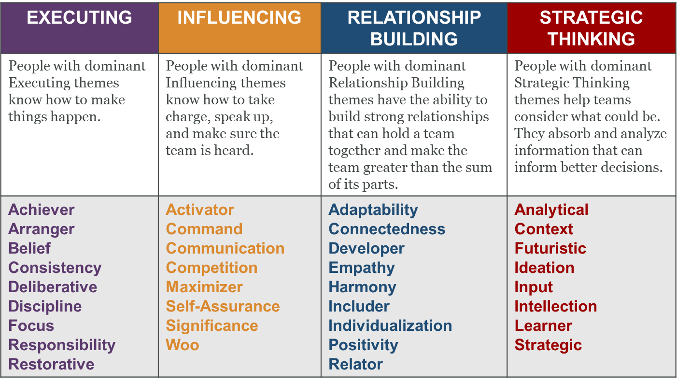
Four Domains of Team Strength
Notes:
Eva - Heads on a Stick will be on a table for pairs to choose

Slide 59
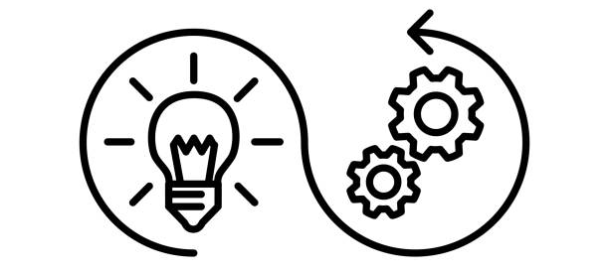
Executing
Knowing how to make things happen – turning ideas into reality and they'll work tirelessly to accomplish the goal
Executing is the domain involving Strengths that are most prepared for hard work and getting the job done. This group of talents is particularly focused on turning ideas into action and is invested in meeting goals. Tireless and focused are words describing Executing Domain Strengths.
Notes:
Neal & Becky

Slide 60
Influencing
Selling ideas inside and outside the company and ensuring the team is heard
The Influencing domain is aware of an audience and knows what that audience values. They take charge, speak up, and make sure others are heard...effortlessly. They can readily affect the emotions and actions of others in a way that inspires those around them to do, see or think differently.
This can happen internally within their own team, or to external constituents. They tend to influence forward, often moving towards action and change.
Notes:
Neal & Becky

Slide 61
Relationship Building
High-performing teams rely on people with strong Relationship Building themes to bring individuals together and make the team greater than the sum of its parts.
They can unite the group and galvanize them to achieve shared success. They are the bond that holds great teams together.
Good relationships rely on good communication, whether it's face-to-face, on the telephone or email. Being open, honest and professional helps establish trust and rapport. Listening is just as important as talking. Active listening is a valuable skill to develop and helps build trust.
Notes:
Neal & Becky

Slide 62
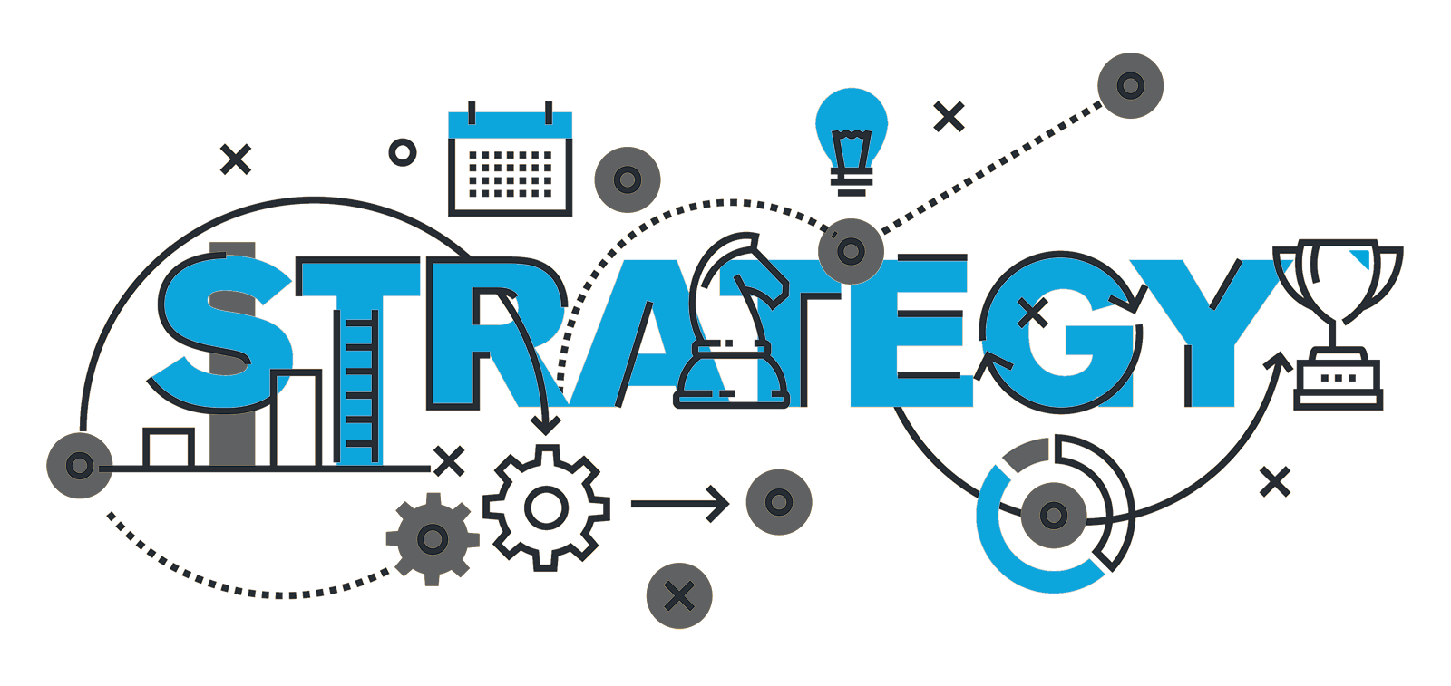
Strategic Thinking
High-performing teams rely on people with strong Strategic Thinking themes to absorb and analyze information that informs better decisions.
When faced with a problem, people with Strategic talents are able to quickly find alternative ways to proceed. You are creative, innovative, unrelenting in the projects you work on, determining the most efficient and the best way to move forward.
You must always take the “most efficient” route. ... You naturally put complex information into categories. ... You have the ability to look ahead at possible outcomes ...
Notes:
Neal & Becky

Slide 63
Team Building Activity
Be prepared to discuss/answer the following:
Who stood out? Why?
Who seemed to take charge? How?
What strengths did you see at work? Examples?
Notes:
Neal & Becky

Slide 64
Survey
growwabashcounty.com/ldwcpostsurvey

Slide 65
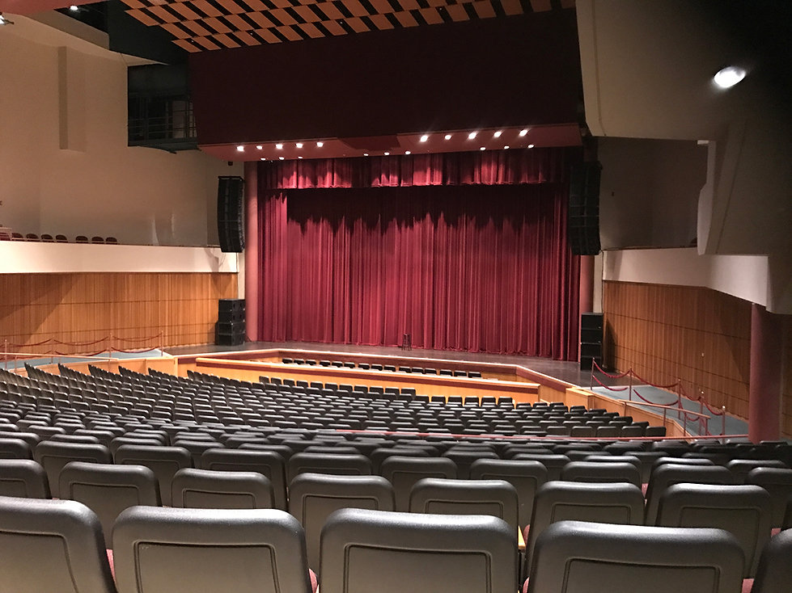
Next Session
Date/Time: Thurs., Feb. 15 from 7:30am-4 pm
Location: Honeywell Center
275 W. Market St
Agenda Overview
State of Our Communities
Government Roundtable Q & A
Anthony Juliano presents Communication Skills for Today’s Leaders
Lunch
Rosalyn Davis presents Power in Differences
Break
Host Tour

