Slide 1
Session: 6 of 8
Date: March 21, 2024
Time: 9:00 am to 5:00 pm
Location: Manchester University
Notes:
Welcome back! I hope you January went awesome!
Say your name and if you won an all-expenses paid vacation, where would it be?
Any celebrations– promotions, babies, houses, etc.?

Slide 2
CORE SPONSORS:
LUNCH SPONSORS:
SCHOLARSHIP SPONSORS:
Notes:
Core Sponsors
Beacon Credit Union – welcome to Chandra & Madyson – last year David & Chris from BCU
City of Wabash – donated their spot so one of you received
Wabash County – welcome to Chrissy from the Deputy Recorder
Lunch Sponsors
Duke Energy
Edward Jones
Josiah Whites
Heartland Career Center
NIPSCO
Ruoff Mortgage
Town of North Manchester – a few North Manchester residents – Jacquelin who lives outside of NM and Kathy Carney who works at Intertech in NM
Real Alloy- welcome to Jerome
Scholarship Sponsors – congrats to the participants who received scholarships
Downtown Wabash, Inc- welcome to Adrianna
City of Wabash
Hoosier Jiffy Print
GWC

Slide 3
Today’s Lunch Sponsor
Notes:
Lunch will be sandwiches and wraps!
Coffee, tea, and other drink refreshments will be provided all day.
Sodas and waters are also available.

Slide 4
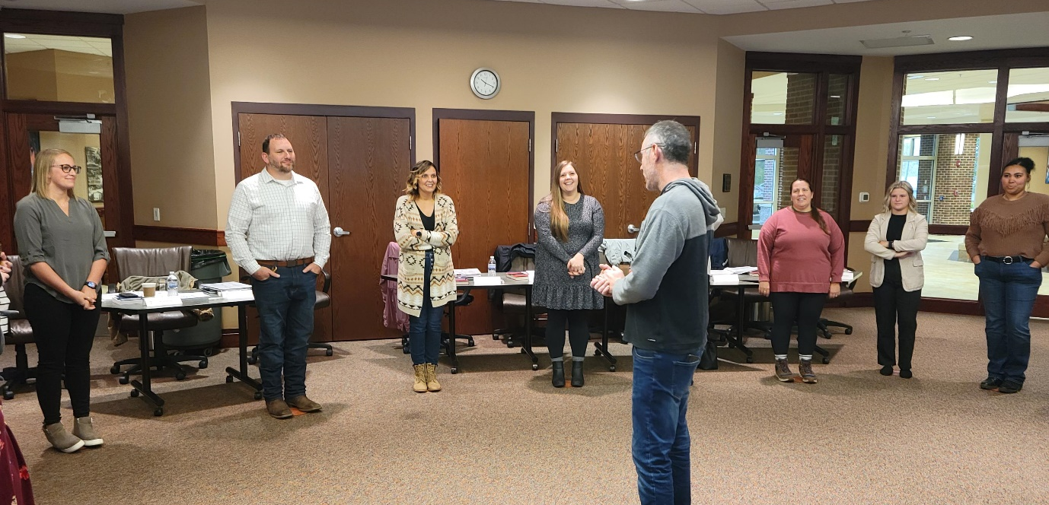
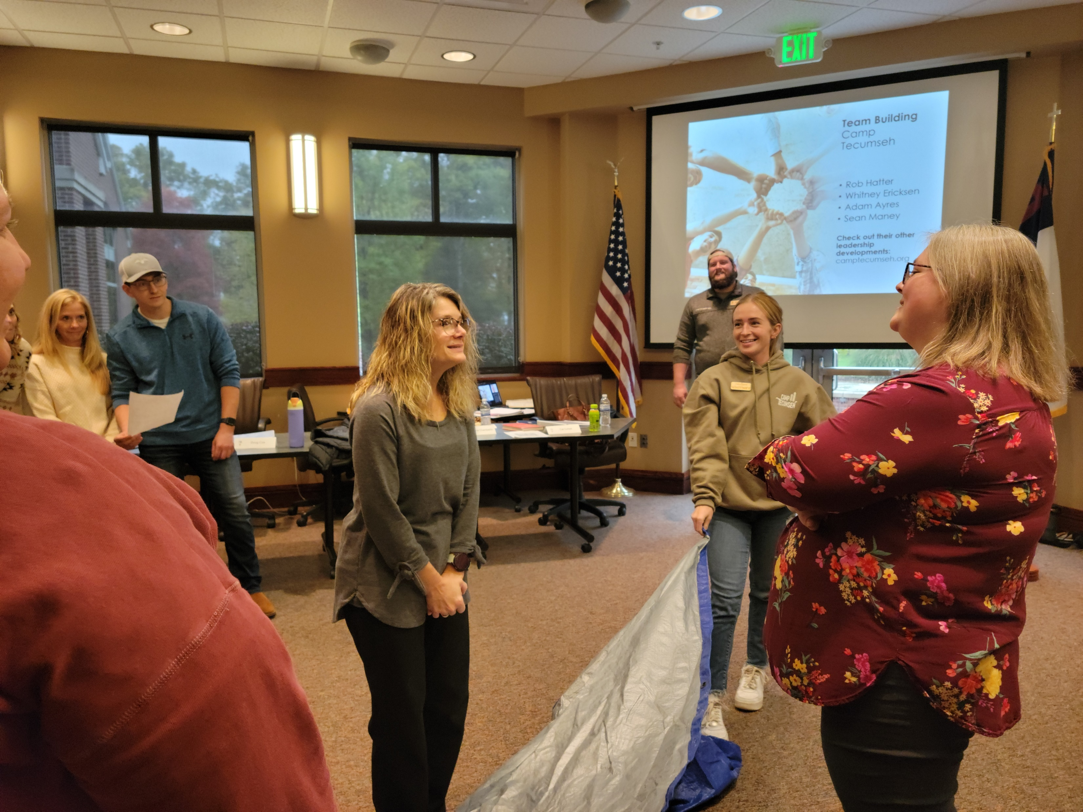
Today’s Agenda
Icebreaker
Panel Service Clubs
Theory to Practice Presentation
Break
Lunch
From Trust to Results Presentation
Break
Host Presentation & Tour

Slide 5
Housing Keeping Items
Restrooms
WiFi Password
Refreshments
Smoking Policy
Notes:
Smoking Policy: We are a tobacco free facility but have designated smoking areas available outside. This includes all tobacco products and e-cigarettes.

Slide 6
Panel Service Clubs

Slide 7
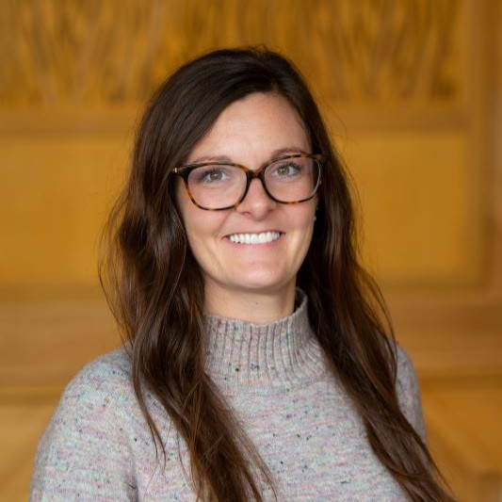
Theory to Practice: Team Presentation and Building Trust Candace Murray (Rhodes), M.A.
Adjunct Professor, Communication, IU Kokomo
Academic Advisor, IU Online Undergraduate
Office of Online Education

Slide 8
Theory to Practice: Team, Presentation and Building Trust Leadership Microcredentials - GWC
Candace Murray (Rhodes) M.A.
Adjunct Professor Communication; Academic Advisor IU
candacer@iu.edu

Slide 9
Learn and practice presentation skills, trust building in teams, and effective small group communication working in teams and project collaboration.
Lead from where you are
Reflection
Working in teams and small groups
Outlining for presentations
Presentation skills
Building trust
What to expect:

Slide 10
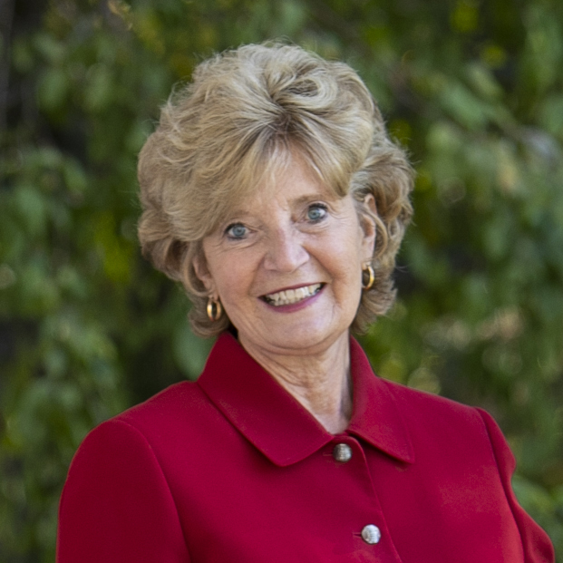
John Maxwell: Lead from where you are
Develop strong relationships with key people (make it a goal to reach out to others and build relationships with them)
Define a win in terms of teamwork
Engage in Continual communication
Gain experience and maturity (“Maturity doesn’t come with age. It begins with the acceptance of responsibility.” – Ed Cole)
Put the team above your personal success
“The bottom line is this: Leadership is a choice you make, not a place you sit”
https://www.success.com/john-maxwell-lead-from-where-you-are/
1. Lead from where you are
Dr. Sue Sciame-Giesecke
Vice President for Regional Campuses and Online Education
“Lead from where you are”

Slide 11
2. Reflection
What has impacted you most about leadership in the last few months?
What, if anything, have you already taken back and started doing in your workplace since this Microcredential Program started?
How has it changed: improved, impacted your work?
What was the biggest take-away from Dr. Preece’s session on ‘From vision to Action: Establishing your leadership plan’?
What was the biggest take-away from my session on ‘Cultivating Self As Leader’?
And in the ‘Put Down the Phone’ paper assignment?
What was the biggest take-away from Dr. Davis’ session on ‘Power in our Differences’?

Slide 12
3. Working in teams and small groups

Slide 13
Small Group/Team Discussion
Most of the images I found initially were images from Church groups advertising Small Groups and in Education esp. K-12
“The benefits of small group instruction in primary grades”
“Connect with a small group”
“Are small groups important for Literacy learning”
“Small Groups doing life together”
“Small Groups life is better in a group”
Why do we have groups in society? Why did our teachers in school assign group work? Why do we have them at work? Socially? What is the purpose?

Slide 14
Define Small Group…
From University of Minnesota (2016) https://open.lib.umn.edu/communication/chapter/13-1-understanding-small-groups/
Interactions among three or more people (upwards of 6, 12, or 15, but only enough or limited to those necessary to accomplish the goal or serve the purpose of the group)
Connected through a common purpose
Mutual influence
Shared identity
Focus on some sort of a task completion or goal accomplishment
Display:
Interdependence
Shared identity
Functions of small groups (different for instrumental, versus relational, versus task needs)

Slide 15
Benefits of Small Groups or working in Teams…
From University of Minnesota (2016) https://open.lib.umn.edu/communication/chapter/13-1-understanding-small-groups/
Successful teams have (Adler & Elmhorst, 2005)
clear and inspiring shared goals,
a results-driven structure,
competent team members,
a collaborative climate,
high standards for performance,
external support and recognition, and
ethical and accountable leadership.
Google Search:
Strengthening communication skills
Increased engagement
Effective collaboration
Innovation
Accountability
More opportunities for feedback

Slide 16
Disadvantages of Small Groups or working in Teams…
From University of Minnesota (2016) https://open.lib.umn.edu/communication/chapter/13-1-understanding-small-groups/
Disadvantages of group communication include:
unnecessary group formation (when the task would be better performed by one person)
difficulty coordinating schedules
difficulty with accountability and social loafing

Slide 17
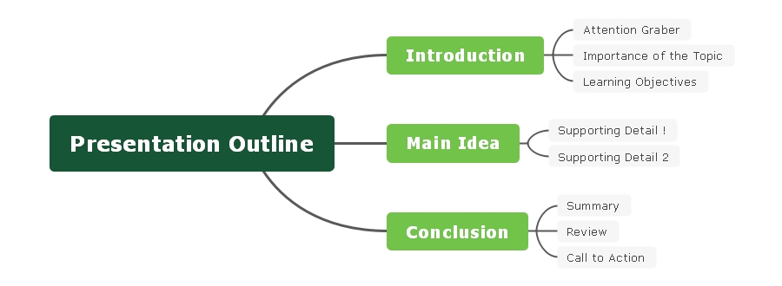
4. Outlining for Presentations

Slide 19
Presentation: INTRODUCTION
Attention Grabber: effective attention grabbers are mindful of the audience, the tone of your topic, the speech’s topic
Start with a fact or statistic
Start with a quote
Start with a short/relevant story
Ask a question (rhetorical or response question)
Visualization
**should be tasteful, relevant, and tactful/professional
Overview of Importance
Why should the audience care enough to listen to you?
Learning Objectives
What are your main points you want to cover?
Repetition is helpful in intro to point out topics, body to reinforce points, and conclusion to remind points.
**remember: most attention spans for adults is 8.25 seconds

Slide 20
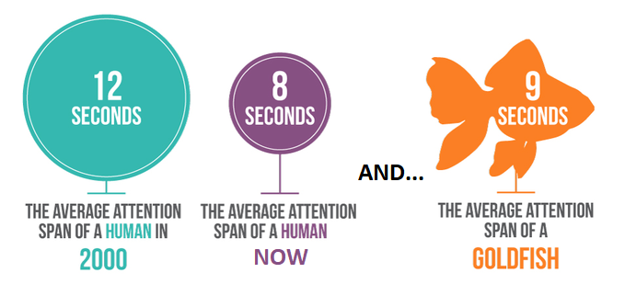
https://www.bridgecareaba.com/blog/average-human-attention-span

Slide 21
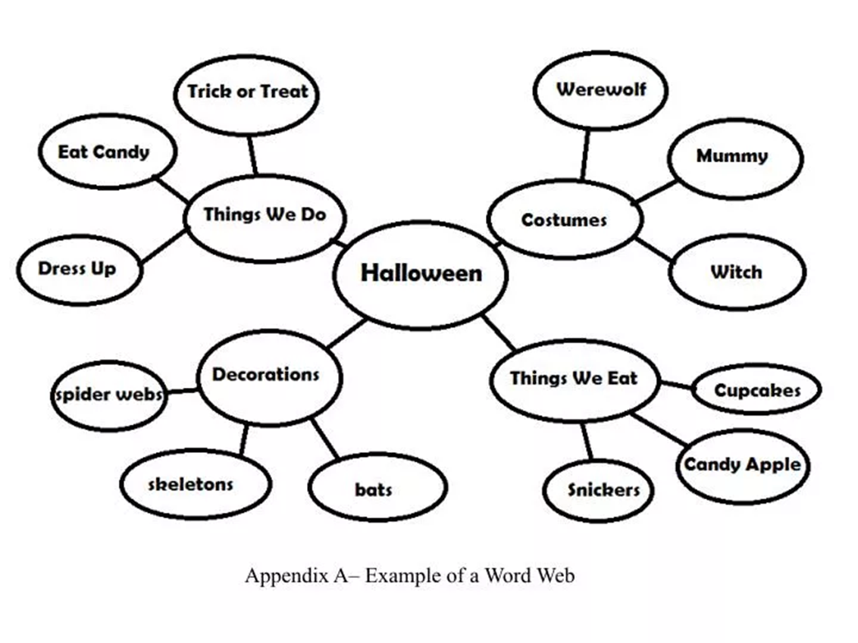
Presentation: BODY
Identify each point
Identify supporting evidence for each point

Slide 22
Presentation: CONCLUSION
“The introduction and conclusion are essential to a speech. The audience will remember the main ideas even If the middle of the speech is a mess or nerves overtake the speaker. So, if nothing else, get these parts down!”
(University of Nevada, Reno https://www.unr.edu/writing-speaking-center/writing-speaking-resources/speech-conclusions )
Signal the ending of the speech
Mindful of tone of voice
Wrap around to the intro attention getter
Re-state your purpose or why this is important
Review
Review points…. (remember the attention span issue…)
Create closure or a sense of finality. (persuasive speeches call to action)

Slide 23
Engage your audience
Make good eye contact
Know your audience
Use appropriate language
Deliver your speech authentically
Do not read notes word-for-word and never look up
Practice, practice, practice
Doesn’t make perfect, but builds confidence
Practice in front of a mirror (mindful of non-verbal skills)
Practice in front of someone else
Seek feedback
Be mindful of filler words (ummm, uh, etc. or vocalized pauses)
Also time yourself and adjust based on required/allotted time
Start strong… End strong
Create a strong intro and conclusion
Good preparation (outline, planning, etc.) will produce a good presentation
Dress the part
Keep it simple
Consider a visual aid (not to distract, or be a clutch, but aid in reinforcing your purpose statement)
5. Presentation Skills

Slide 24
Now we practice….. Of course, in small groups

Slide 25
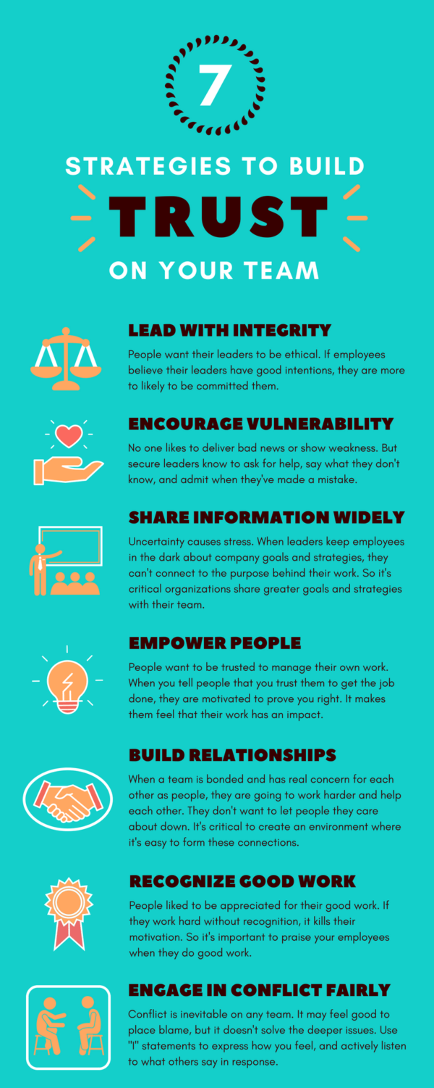
6. Building Trust
“Contrary to what most people believe, trust is not some soft, illusive quality that you either have or you don’t; rather, trust is a pragmatic, tangible, actionable asset that you can create.”
– Stephen R. Covey
https://hive.com/blog/team-trust/

Slide 26
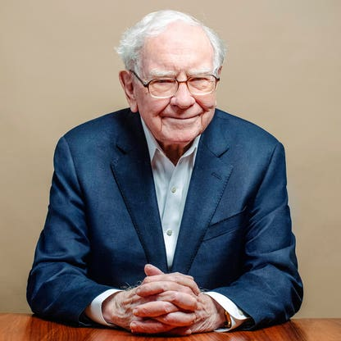
“Trust is like the air we breathe – when it’s present, nobody really notices; when it’s absent, everybody notices.”
– Warren Buffett
https://hive.com/blog/team-trust/

Slide 27
Next session on Practical Approaches for Leaders!!! with Dr. Preece
Today! March 21, 2024
Remember:
All of this culminates in a Leadership plan.
Articulate a clear, achievable action plan for implementing one's own plan for leadership development
Additional plan for supporting colleague/employee growth and development
Presentations May 16, 2024
Next session on Trust for Leaders!!!

Slide 28
*Examine delivery styles and organization methods for presenting information and gaining confidence speaking to a group of people. P5, S8
*Develop skills to effectively deliver a presentation being mindful of non-verbal communication, delivery, and organization. P21, P22
*Analyze small group theory to identify effective and ineffective methods of working in teams, building from the lens of interpersonal theory and cultural competencies. P29
*Recognize the critical role trust in building effective teams, developing client relationships and leadership development. P28, P6
Learning outcomes

Slide 29
Bridge Care ABA (©2024). Average human attention span by age: 60 statistics. Retrieved 3.15.24 from https://www.bridgecareaba.com/blog/average-human-attention-span
Hive.com (2018, August 22). How to build trust on your team. Retrieved 3.15.24 from https://hive.com/blog/team-trust/
Success.com (2010, Nov. 1). John Maxwell: Lead from where you are. Retrieved 3.15.24 from https://www.success.com/john-maxwell-lead-from-where-you-are/
Article by Elisa Henry
University of Minnesota Libraries (2024). 13.1 Understanding small groups. Retrieved 3.15.24 from https://open.lib.umn.edu/communication/chapter/13-1-understanding-small-groups/
Communication in the Real World Copyright © 2016 by University of Minnesota is licensed under a Creative Commons Attribution-NonCommercial-ShareAlike 4.0 International License, except where otherwise noted.
University Writing & Speaking Center, University of Nevada, Reno (2024). Speech conclusions. Retrieved 3.15.24 from https://www.unr.edu/writing-speaking-center/writing-speaking-resources/speech-conclusions
References (and many of the links are great articles to read)

Slide 30
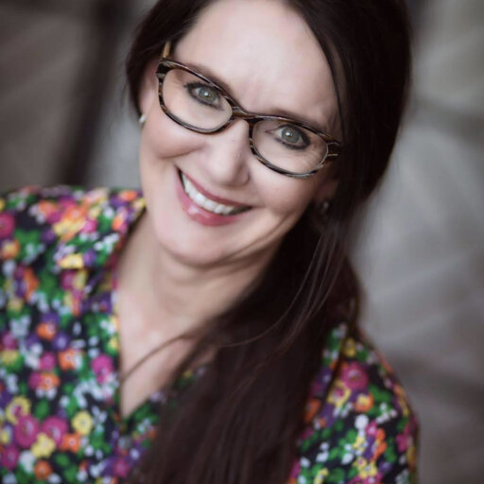
From Trust to Results: Practical Approaches for Leaders Gloria Preece, PhD
Assistant Professor of Marketing and Personal Financial Planning
Assistant Dean and Director of the M.B.A. & M.P.M. Programs
IU Office of Education Abroad Campus Coordinator
School of Business Indiana University Kokomo

Slide 31
Today’s Lunch Sponsor
Notes:
Lunch will be sandwiches and wraps!
Coffee, tea, and other drink refreshments will be provided all day.
Sodas and waters are also available.

Slide 32
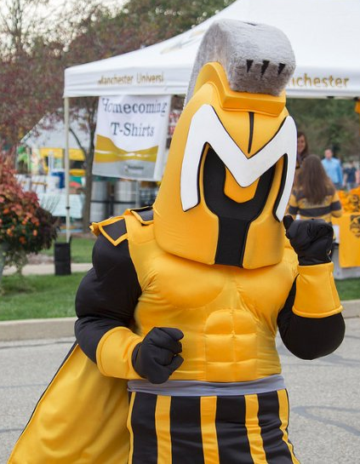
Host Presentation & Tour
Manchester University
Notes:
Lunch will be sandwiches and wraps!
Coffee, tea, and other drink refreshments will be provided all day.
Sodas and waters are also available.

Slide 33
Survey
growwabashcounty.com/ldwcpostsurvey

Slide 34
Next Session
Date/Time: Thurs., April 18 from 9-5 pm
Location: Grow Wabash County
214 S Wabash St.
Wabash, IN 46992
Agenda Overview:
Review of Programs
Community Development Panel
Anthony Juliano Presentation
Trolly & Business Etiquette Luncheon
Group Book Summary
Dismissal
Optional – Young Professional & LDWC Mixer @ Moon Dog

